Slide 1





Databases & SQL

Slide 2

Hello!
I am Eslam Ahmed
I am a software engineer.
You can find me at jeksogsa@gmail.com

Slide 3

Hello!
I am Eman Ehab
I am a ML research engineer.
You can find me at emanehab.ieee@gmail.com

Slide 4
Agenda
What is RDBMS.
Tables, Columns and Data types
How to design a database.
One-To-Many & Many-To-Many Relationships.
Examples: FB, Youtube, Souq.com
SQL
CRUD
Selecting data
Filtering data
Ordering data
Limiting data
Aggregate Functions
Joining tables
Grouping data
Subqueries
Inserting new data
Updating data
Deleting data
Python and SQLite
DB Browser for SQLite

Slide 5
Agenda
What is RDBMS.
Tables, Columns and Data types
How to design a database.
One-To-Many & Many-To-Many Relationships.
Examples: FB, Youtube, Souq.com
SQL
CRUD
Selecting data
Filtering data
Ordering data
Limiting data
Aggregate Functions
Joining tables
Grouping data
Subqueries
Inserting new data
Updating data
Deleting data
Python and SQLite
DB Browser for SQLite

Slide 6
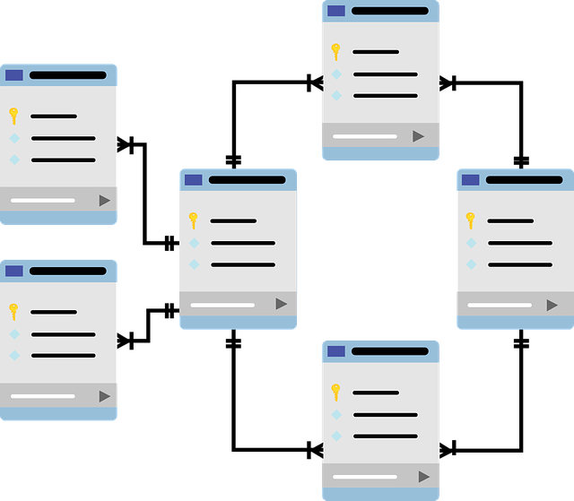
What is RDBMS. (relational database management system)
File systems made for storing and
manipulating relational data.
Data organized in tabular form each
table represents an entity like users,
products, categories, etc…
Each table consists of columns that
represent entity properties, each
column can be any data type like
numbers, text, etc…
SQL is an easy language to connect
with database and query the data
from it easily.

Slide 7
Agenda
What is RDBMS.
Tables, Columns and Data types
How to design a database.
One-To-Many & Many-To-Many Relationships.
Examples: FB, Youtube, Souq.com
SQL
CRUD
Selecting data
Filtering data
Ordering data
Limiting data
Aggregate Functions
Joining tables
Grouping data
Subqueries
Inserting new data
Updating data
Deleting data
Python and SQLite
DB Browser for SQLite

Slide 8
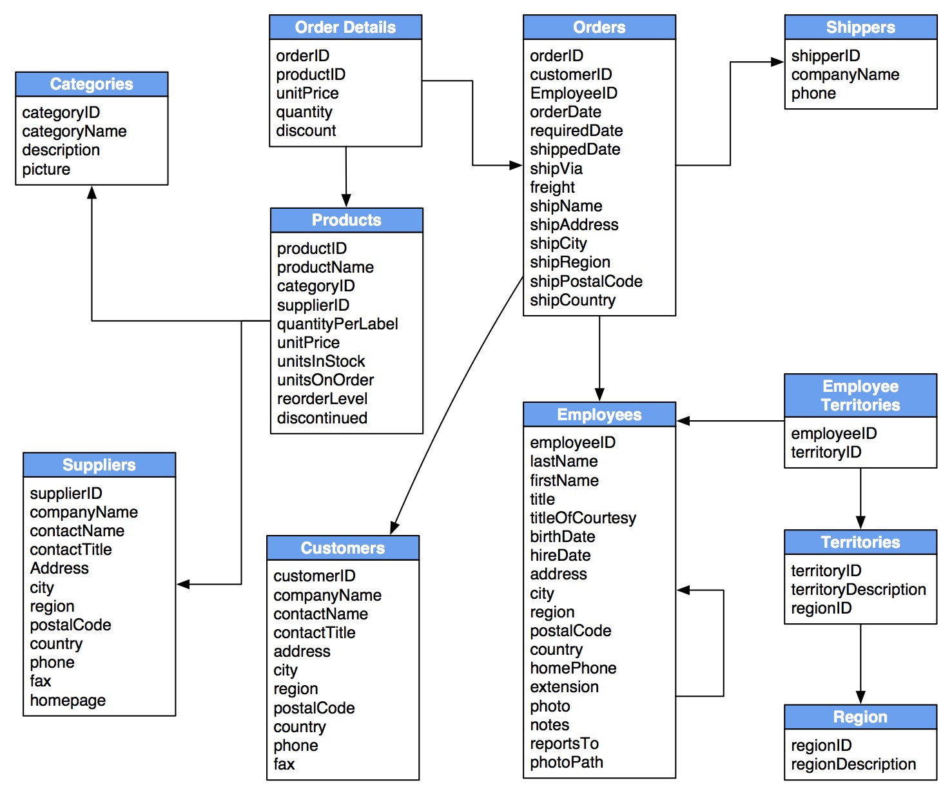



Tables, Columns and Data types
Tables
Users, posts, comments, products, …
Columns
Users table have columns like age,
gender, username, email, is_online,…
Data Types
Age is Numeric, username is TEXT
Gender is CHAR, is_online is BOOL

Slide 9
Agenda
What is RDBMS.
Tables, Columns and Data types
How to design a database.
One-To-Many & Many-To-Many Relationships.
Examples: FB, Youtube, Souq.com
SQL
CRUD
Selecting data
Filtering data
Ordering data
Limiting data
Aggregate Functions
Joining tables
Grouping data
Subqueries
Inserting new data
Updating data
Deleting data
Python and SQLite
DB Browser for SQLite

Slide 10
How to design a database.
1) Analyze the system and divide it to its main entities (tables).
-------------------------------------------------------
for example we make an ecommerce system so the main entities tables are Categories, Products, Orders, Customers, etc…
2) For each table define what its properties (columns) are and what is their data types.
-------------------------------------------------------------
for example customers table have name, city ,phone and products table have price, name, etc.., the most important thing don’t forget to add the unique auto increment id column (Primary Key) because it’s the row identifier.
3) Define tables relationships and based on the relationship define the foreign keys.
------------------------------------------------------------
for example one-to-many relationship between the products and categories tables so we define the CategoryID column (Foreign Key) in the products table, another relation is many-to-many relation between orders and products tables so we make Order Details table that contain the foreign keys

Slide 11
Agenda
What is RDBMS.
Tables, Columns and Data types
How to design a database.
One-To-Many & Many-To-Many Relationships.
Examples: FB, Youtube, Souq.com
SQL
CRUD
Selecting data
Filtering data
Ordering data
Limiting data
Aggregate Functions
Joining tables
Grouping data
Subqueries
Inserting new data
Updating data
Deleting data
Python and SQLite
DB Browser for SQLite

Slide 12
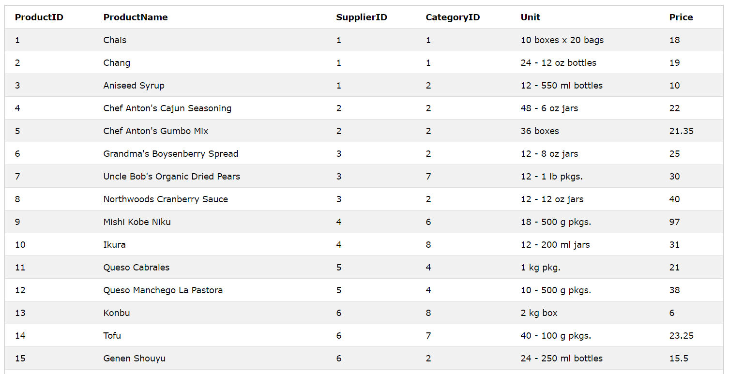
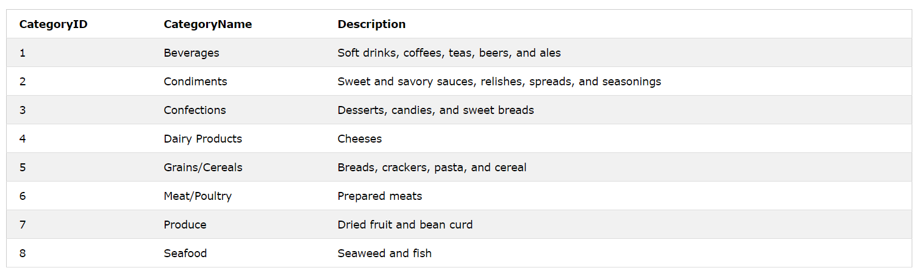
One-To-Many & Many-To-Many Relationships
Products --->
CategoryID is a foreign key that point to the CategoryID primary key in categories table
<--- Categories
CategoryID is a primary key

Slide 13

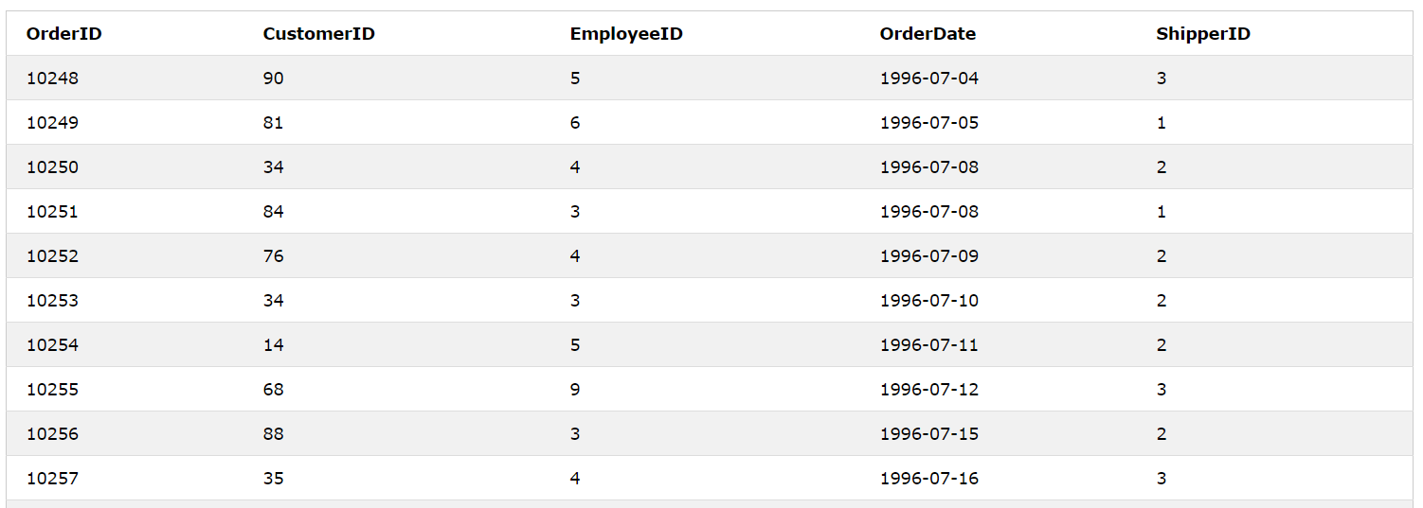
One-To-Many & Many-To-Many Relationships
Products --->
How can we represent the relationship ?!
Orders --->

Slide 14
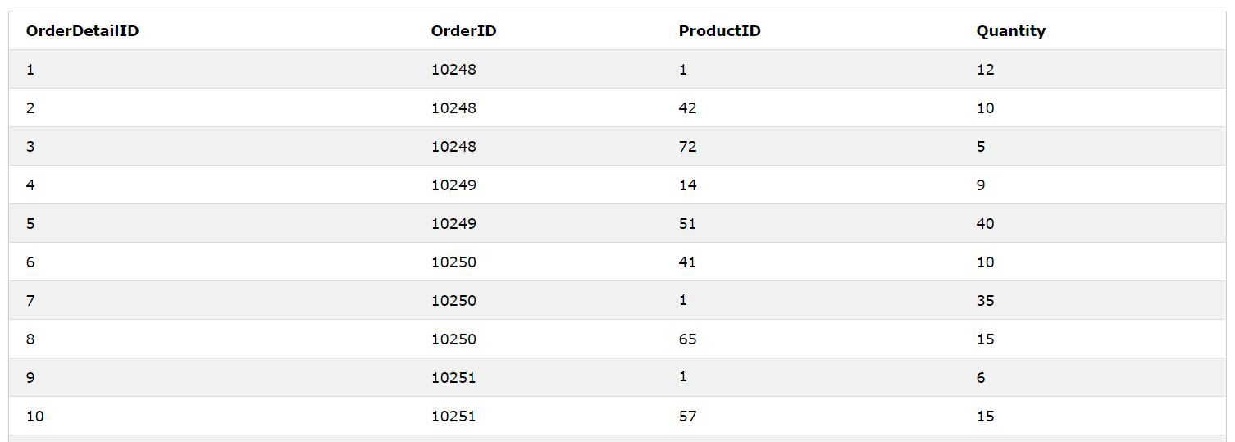
Products
One-To-Many & Many-To-Many Relationships
Order Details
Orders
We make a new table that have both foreign keys

Slide 15
Agenda
What is RDBMS.
Tables, Columns and Data types
How to design a database.
One-To-Many & Many-To-Many Relationships.
Examples: FB, Youtube, Souq.com
SQL
CRUD
Selecting data
Filtering data
Ordering data
Limiting data
Aggregate Functions
Joining tables
Grouping data
Subqueries
Inserting new data
Updating data
Deleting data
Python and SQLite
DB Browser for SQLite

Slide 16



Examples: FB, Youtube, Souq.com

Slide 17
Agenda
What is RDBMS.
Tables, Columns and Data types
How to design a database.
One-To-Many & Many-To-Many Relationships.
Examples: FB, Youtube, Souq.com
SQL
CRUD
Selecting data
Filtering data
Ordering data
Limiting data
Aggregate Functions
Joining tables
Grouping data
Subqueries
Inserting new data
Updating data
Deleting data
Python and SQLite
DB Browser for SQLite

Slide 18

SQL
SQL or Structured Query Language used to communicate with the database by executing commands for creating tables and columns and also reading, filtering, ordering, inserting, updating, deleting data and more.
You can try SQL on bunch of examples from this link
https://www.w3schools.com/sql/default.asp
https://www.sqlitetutorial.net

Slide 19
Agenda
What is RDBMS.
Tables, Columns and Data types
How to design a database.
One-To-Many & Many-To-Many Relationships.
Examples: FB, Youtube, Souq.com
SQL
CRUD
Selecting data
Filtering data
Ordering data
Limiting data
Aggregate Functions
Joining tables
Grouping data
Subqueries
Inserting new data
Updating data
Deleting data
Python and SQLite
DB Browser for SQLite

Slide 20
CRUD
C R U D
Create
Read
Update
Delete

Slide 21
Agenda
What is RDBMS.
Tables, Columns and Data types
How to design a database.
One-To-Many & Many-To-Many Relationships.
Examples: FB, Youtube, Souq.com
SQL
CRUD
Selecting data
Filtering data
Ordering data
Limiting data
Aggregate Functions
Joining tables
Grouping data
Subqueries
Inserting new data
Updating data
Deleting data
Python and SQLite
DB Browser for SQLite

Slide 22
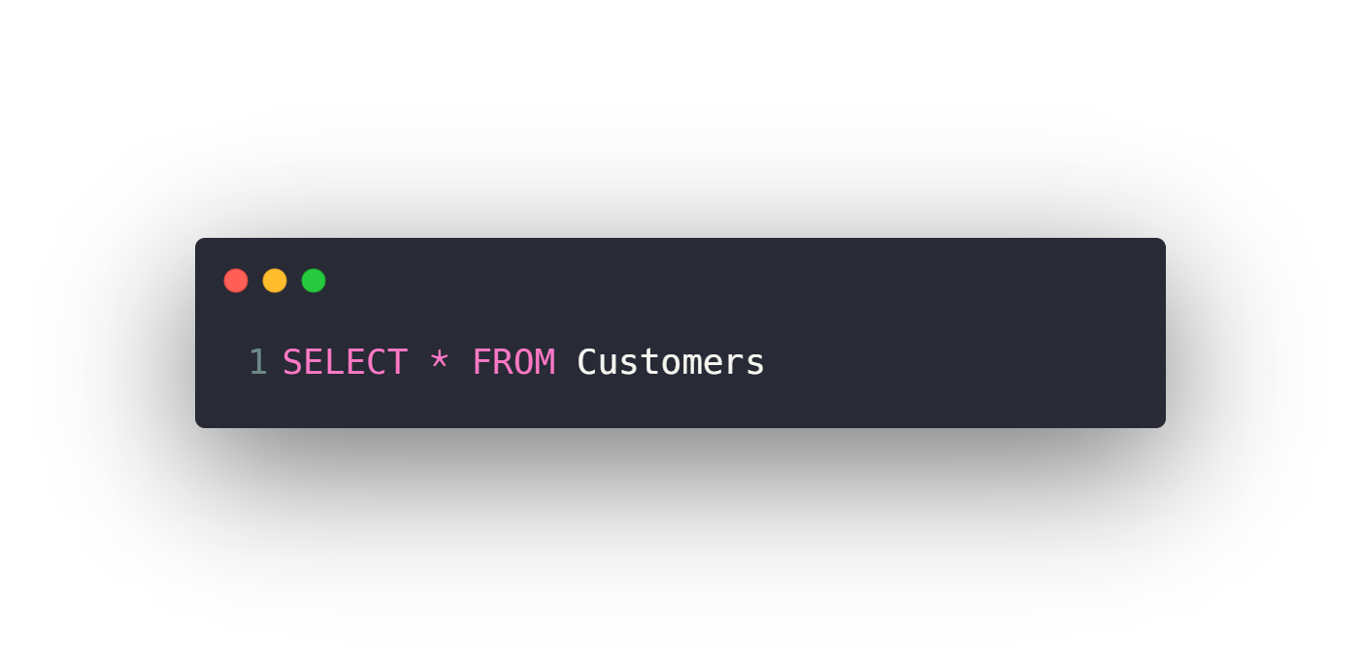
Selecting data
Select all columns from a table
Select specific columns from a table

Slide 23
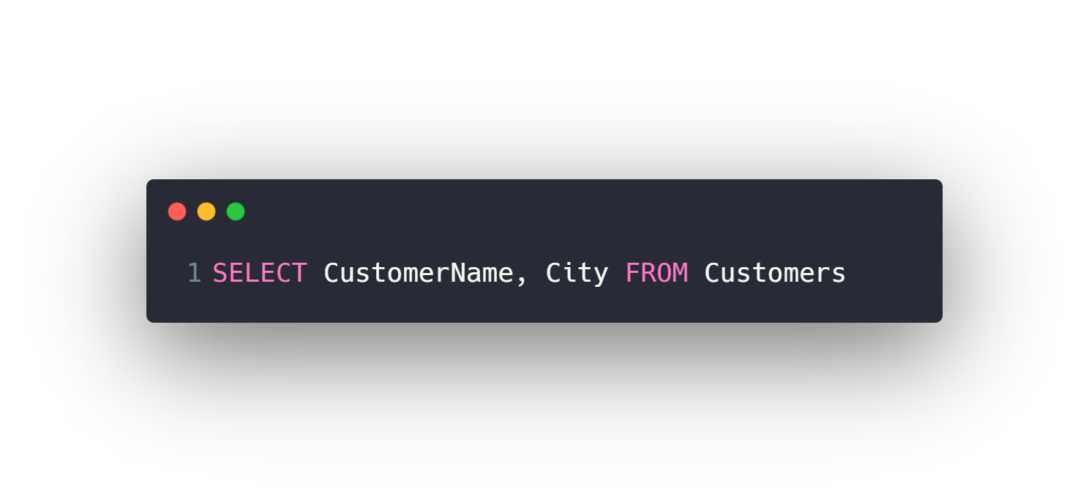
Selecting data
Select all columns from a table
Select specific columns from a table

Slide 24
Agenda
What is RDBMS.
Tables, Columns and Data types
How to design a database.
One-To-Many & Many-To-Many Relationships.
Examples: FB, Youtube, Souq.com
SQL
CRUD
Selecting data
Filtering data
Ordering data
Limiting data
Aggregate Functions
Joining tables
Grouping data
Subqueries
Inserting new data
Updating data
Deleting data
Python and SQLite
DB Browser for SQLite

Slide 25
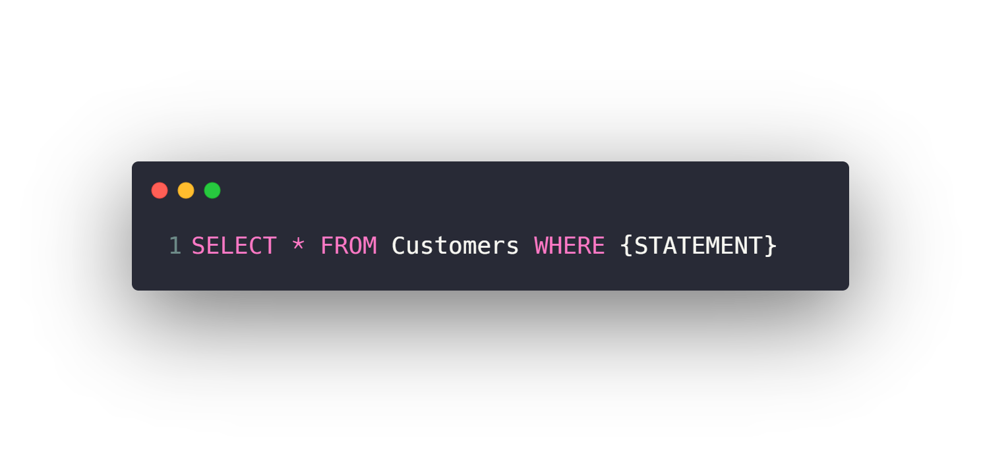
Filtering data
WHERE Clause
Filtering with Text vs Numeric Fields
Comparison operators (>, <, >=, <=, =, <>)
BETWEEN
IN
LIKE
Logic operators (AND, OR, NOT)
IS NULL, IS NOT NULL

Slide 26
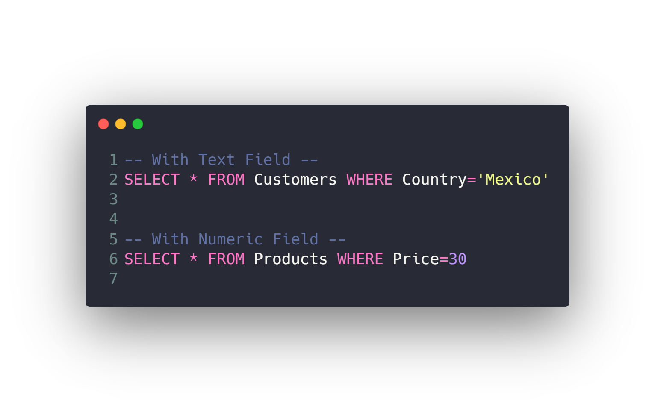
Filtering data
WHERE Clause
Filtering with Text vs Numeric Fields
Comparison operators (>, <, >=, <=, =, <>)
BETWEEN
IN
LIKE
Logic operators (AND, OR, NOT)
IS NULL, IS NOT NULL

Slide 27
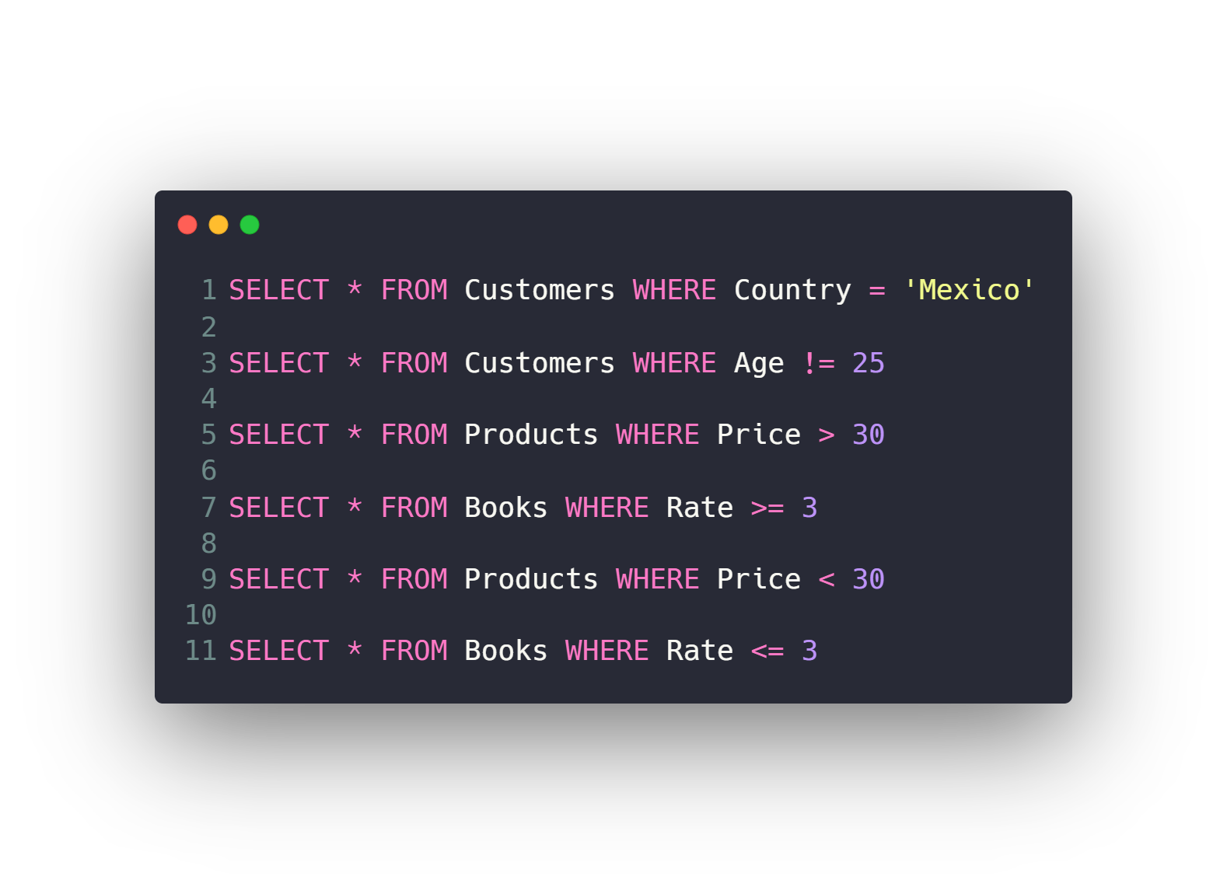
Filtering data
WHERE Clause
Filtering with Text vs Numeric Fields
Comparison operators (=, !=, >, <, >=, <=)
BETWEEN
IN
LIKE
Logic operators (AND, OR, NOT)
IS NULL, IS NOT NULL

Slide 28
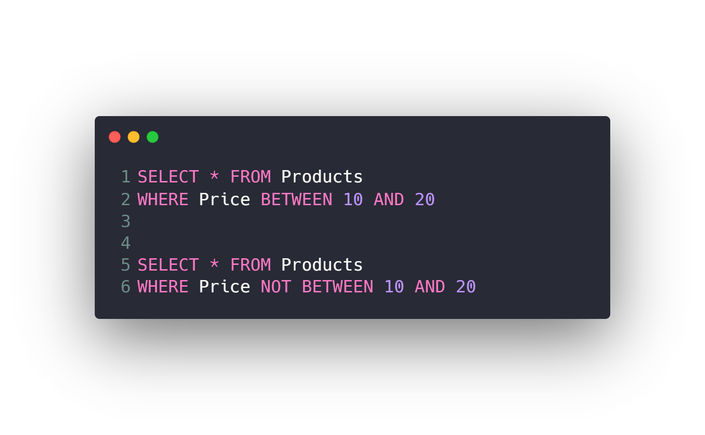
Filtering data
WHERE Clause
Filtering with Text vs Numeric Fields
Comparison operators (=, !=, >, <, >=, <=)
BETWEEN
IN
LIKE
Logic operators (AND, OR, NOT)
IS NULL, IS NOT NULL

Slide 29
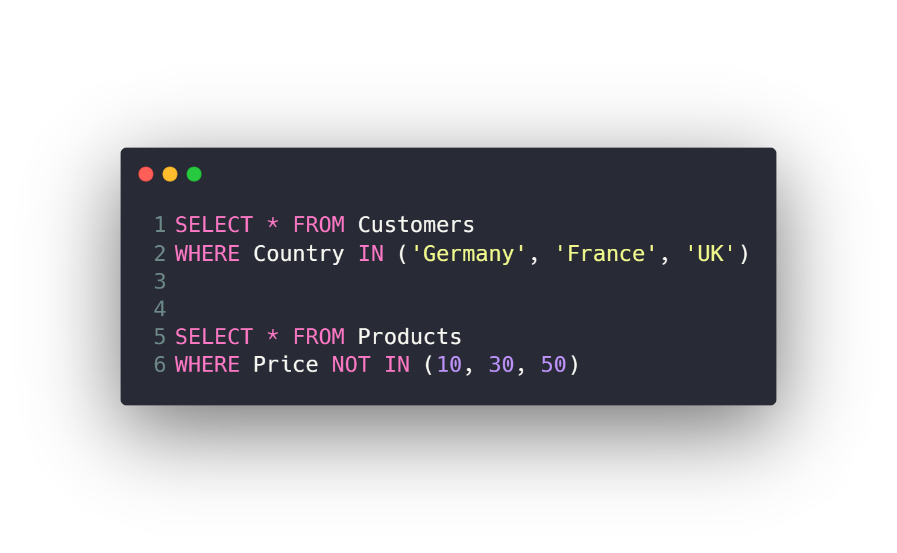
Filtering data
WHERE Clause
Filtering with Text vs Numeric Fields
Comparison operators (=, !=, >, <, >=, <=)
BETWEEN
IN
LIKE
Logic operators (AND, OR, NOT)
IS NULL, IS NOT NULL

Slide 30
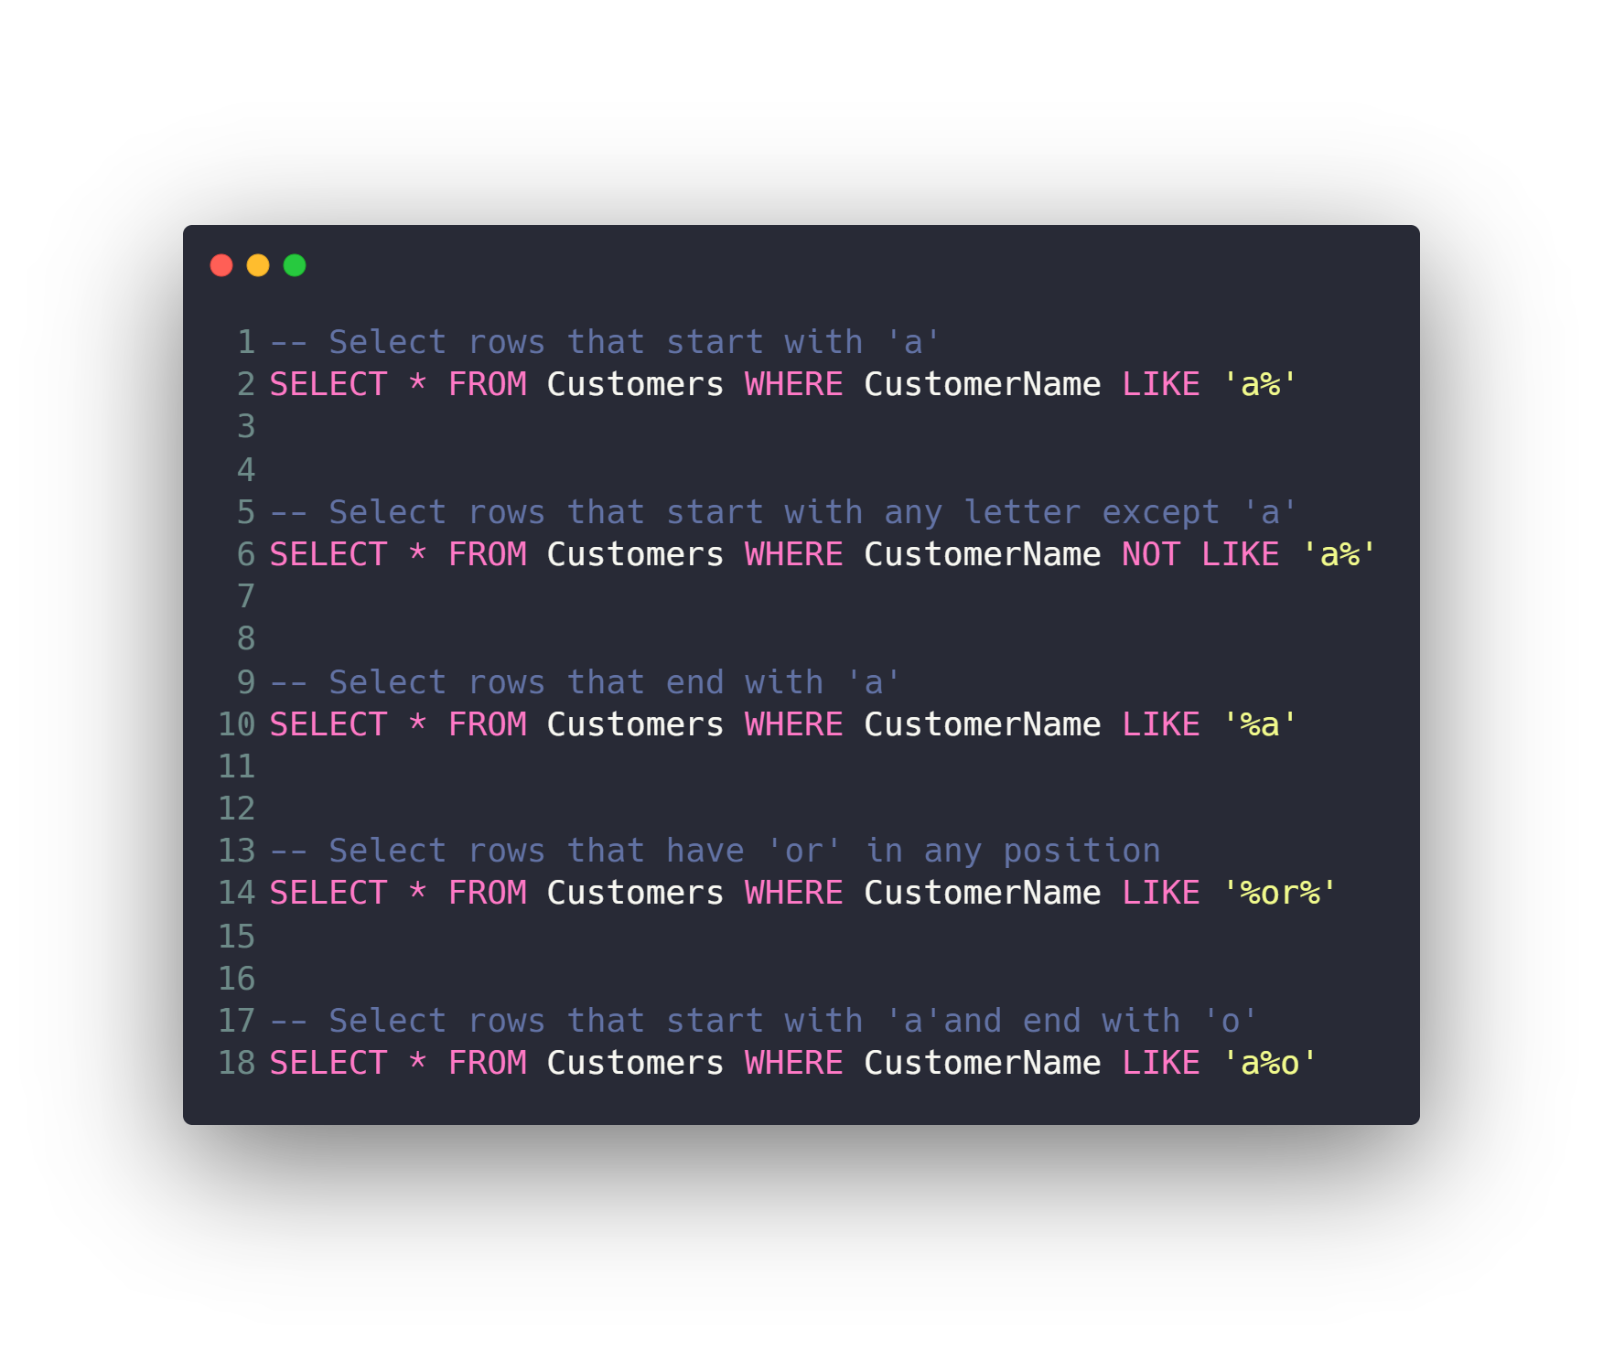
Filtering data
WHERE Clause
Filtering with Text vs Numeric Fields
Comparison operators (=, !=, >, <, >=, <=)
BETWEEN
IN
LIKE
Logic operators (AND, OR, NOT)
IS NULL, IS NOT NULL

Slide 31
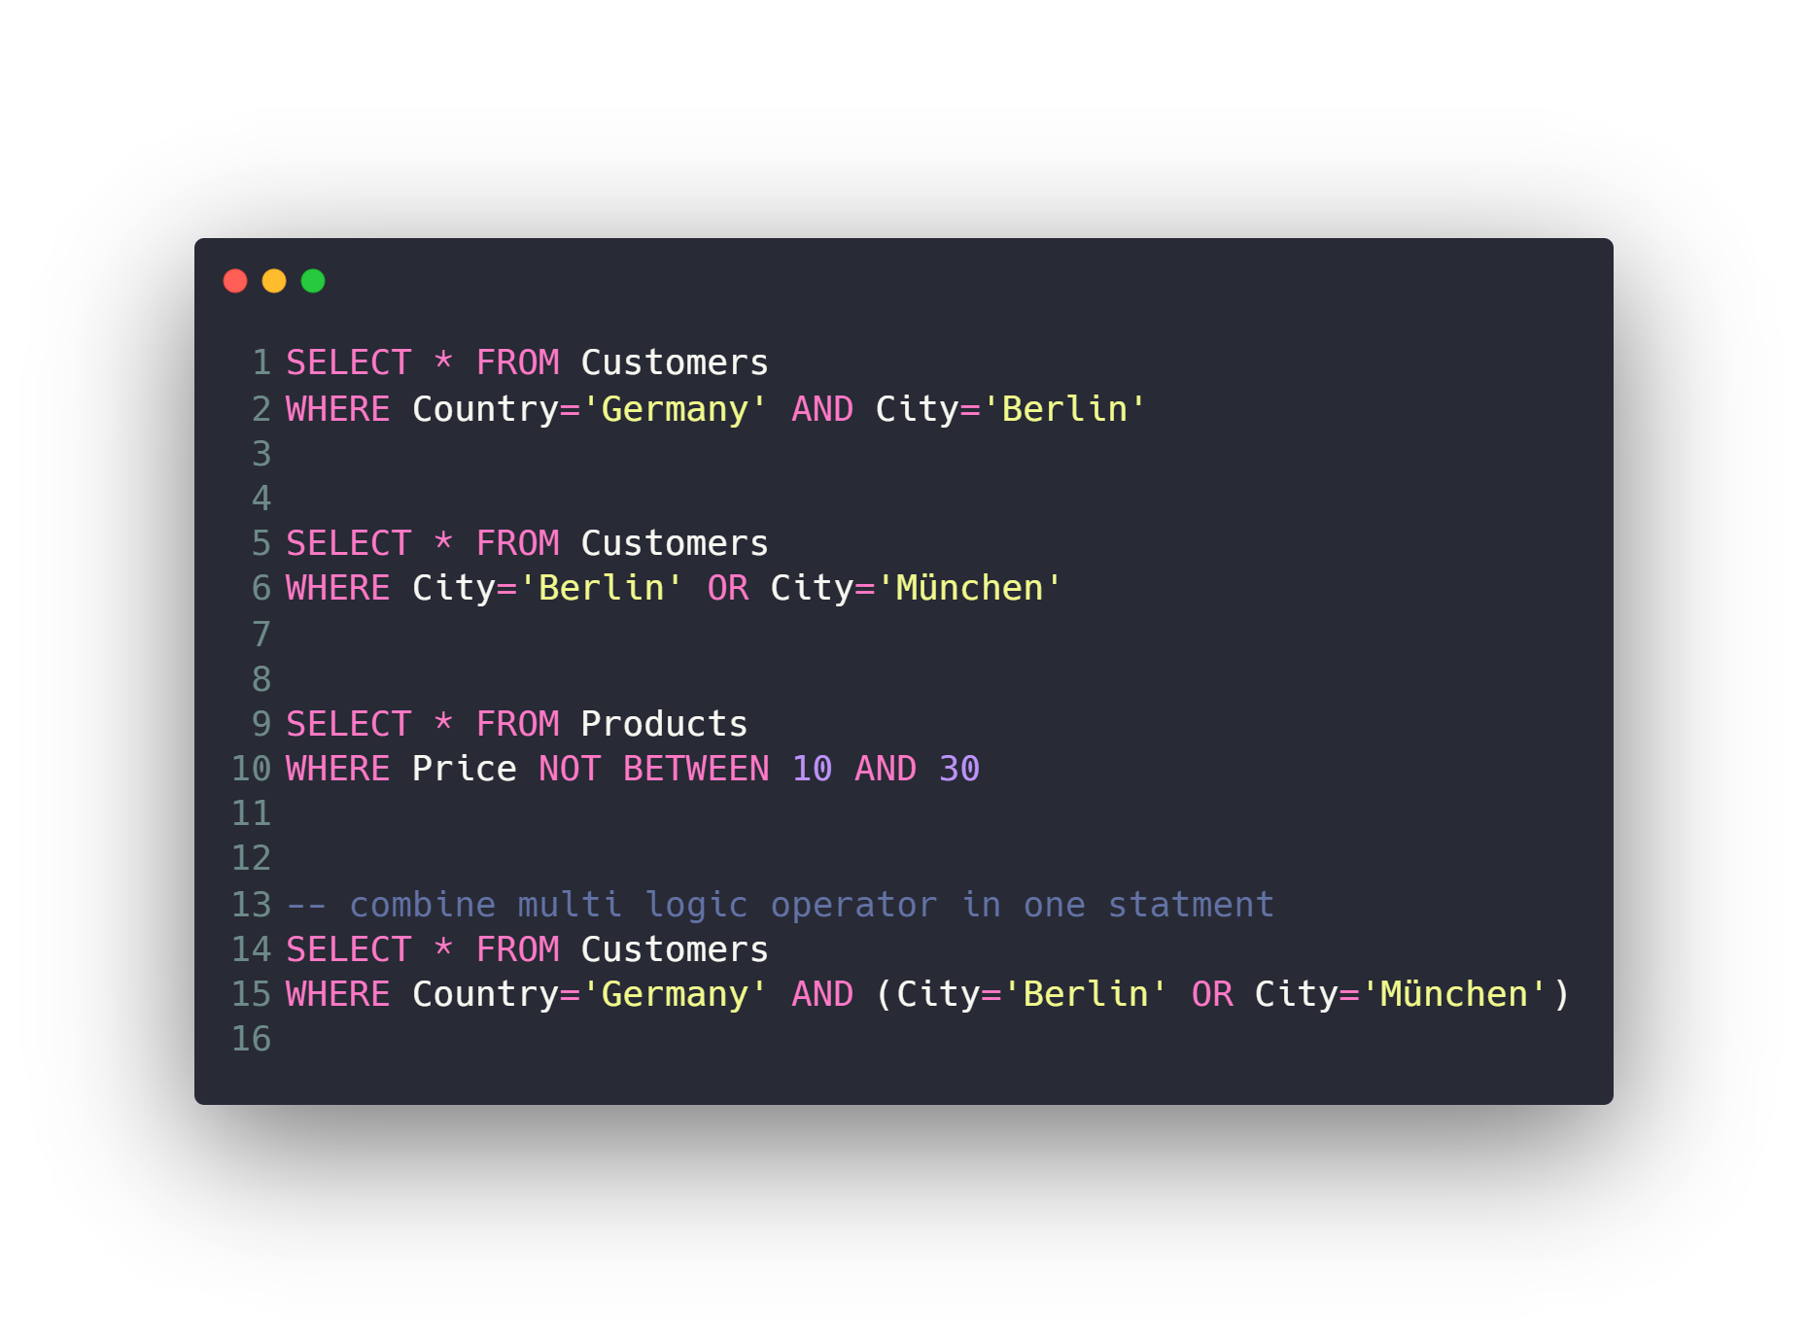
Filtering data
WHERE Clause
Filtering with Text vs Numeric Fields
Comparison operators (=, !=, >, <, >=, <=)
BETWEEN
IN
LIKE
Logic operators (AND, OR, NOT)
IS NULL, IS NOT NULL

Slide 32
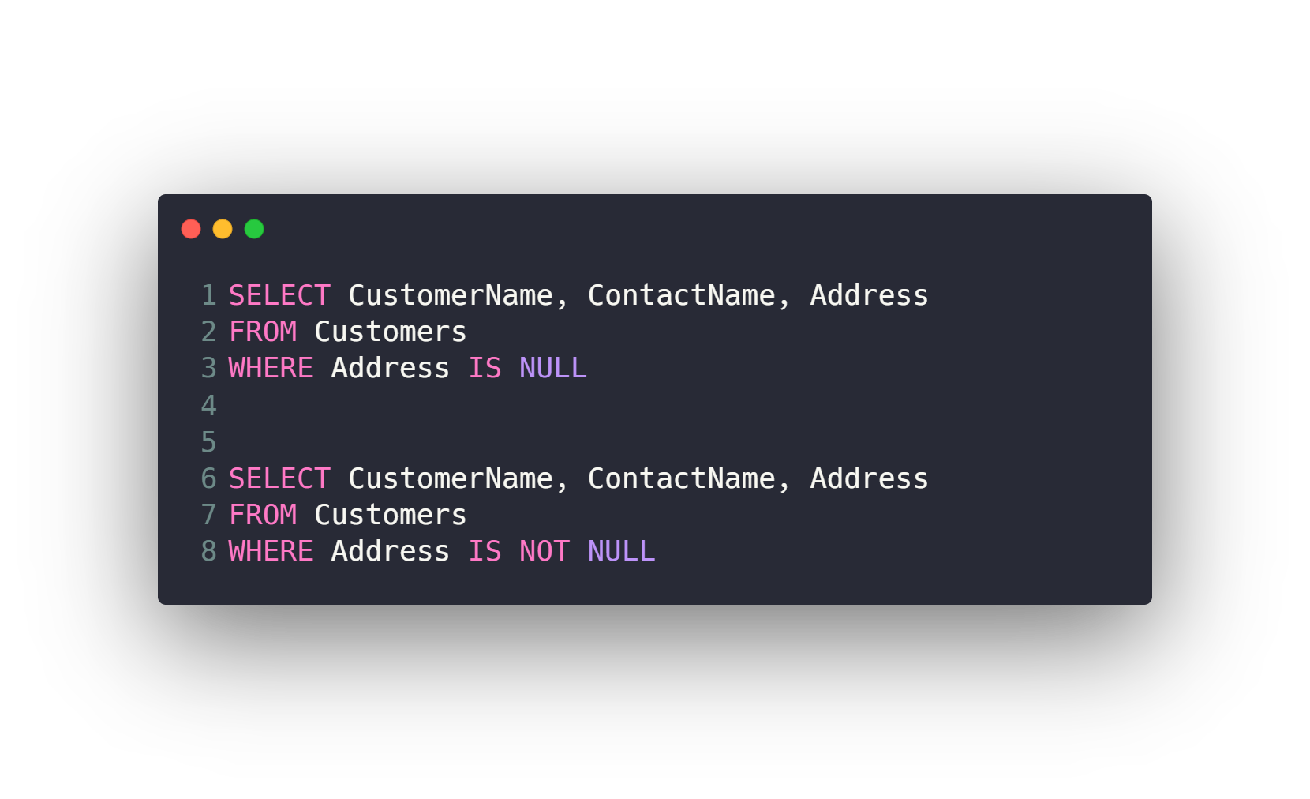
Filtering data
WHERE Clause
Filtering with Text vs Numeric Fields
Comparison operators (=, !=, >, <, >=, <=)
BETWEEN
IN
LIKE
Logic operators (AND, OR, NOT)
IS NULL, IS NOT NULL

Slide 33
Agenda
What is RDBMS.
Tables, Columns and Data types
How to design a database.
One-To-Many & Many-To-Many Relationships.
Examples: FB, Youtube, Souq.com
SQL
CRUD
Selecting data
Filtering data
Ordering data
Limiting data
Aggregate Functions
Joining tables
Grouping data
Subqueries
Inserting new data
Updating data
Deleting data
Python and SQLite
DB Browser for SQLite

Slide 34
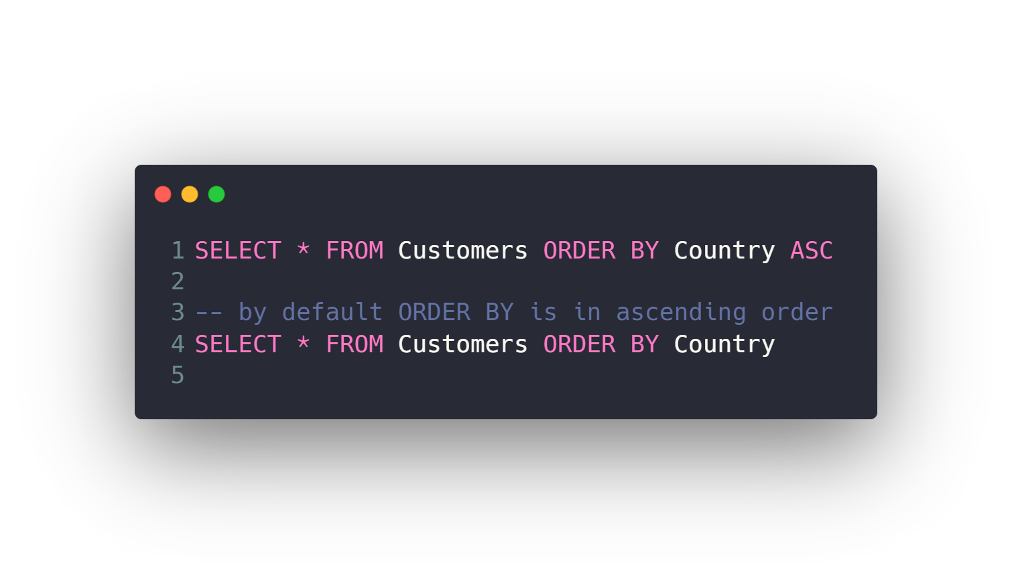
Ordering data
Order rows by single column ascending
Order rows by single column descending
Filter then Order
Order rows by several columns

Slide 35
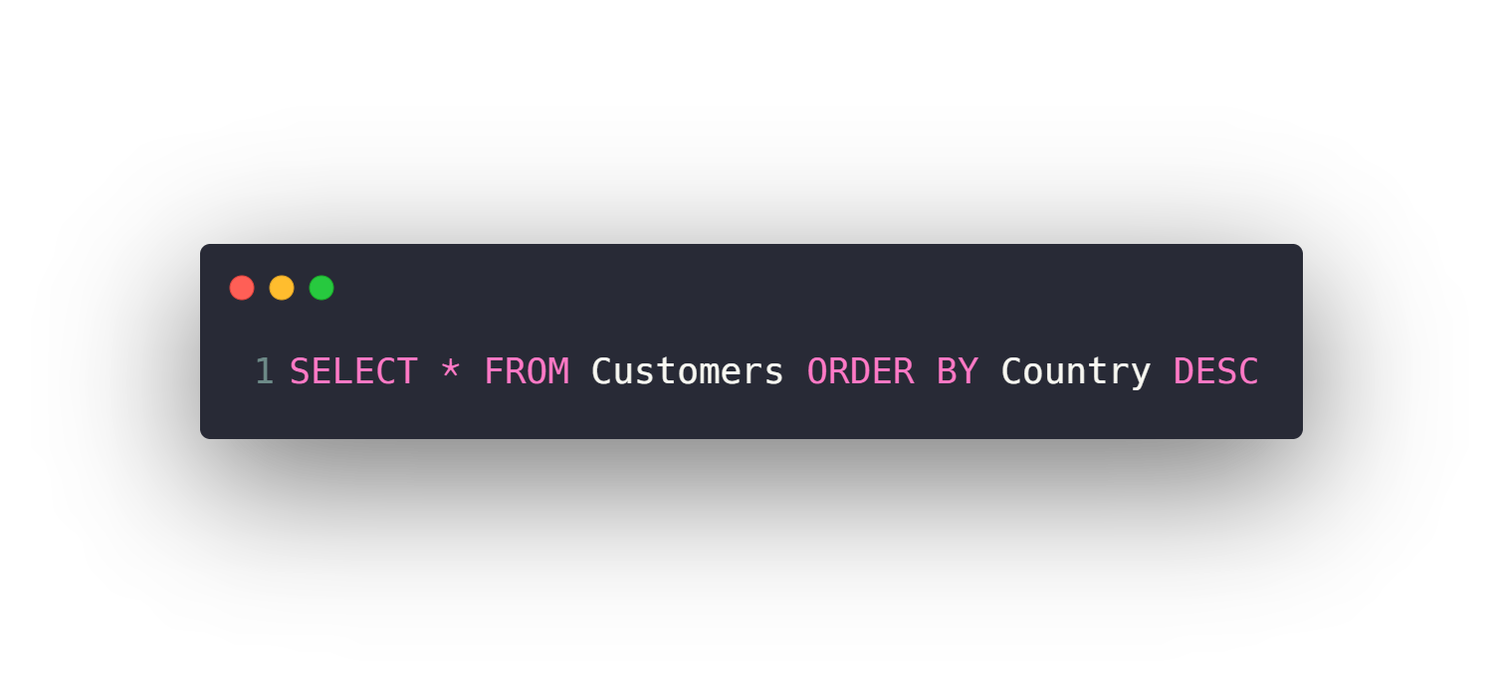
Ordering data
Order rows by single column ascending
Order rows by single column descending
Filter then Order
Order rows by several columns

Slide 36
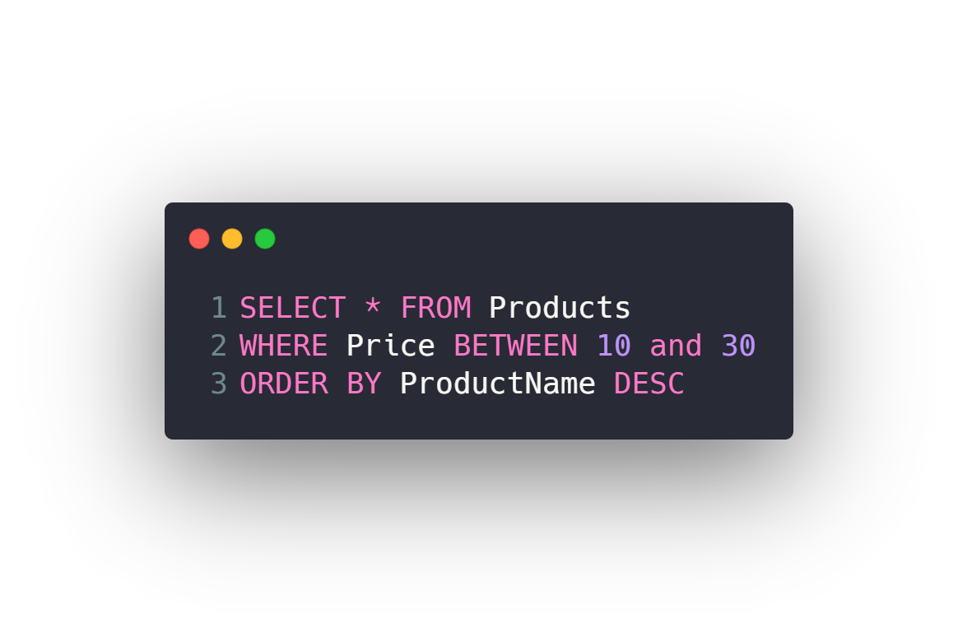
Ordering data
Order rows by single column ascending
Order rows by single column descending
Filter then Order
Order rows by several columns

Slide 37
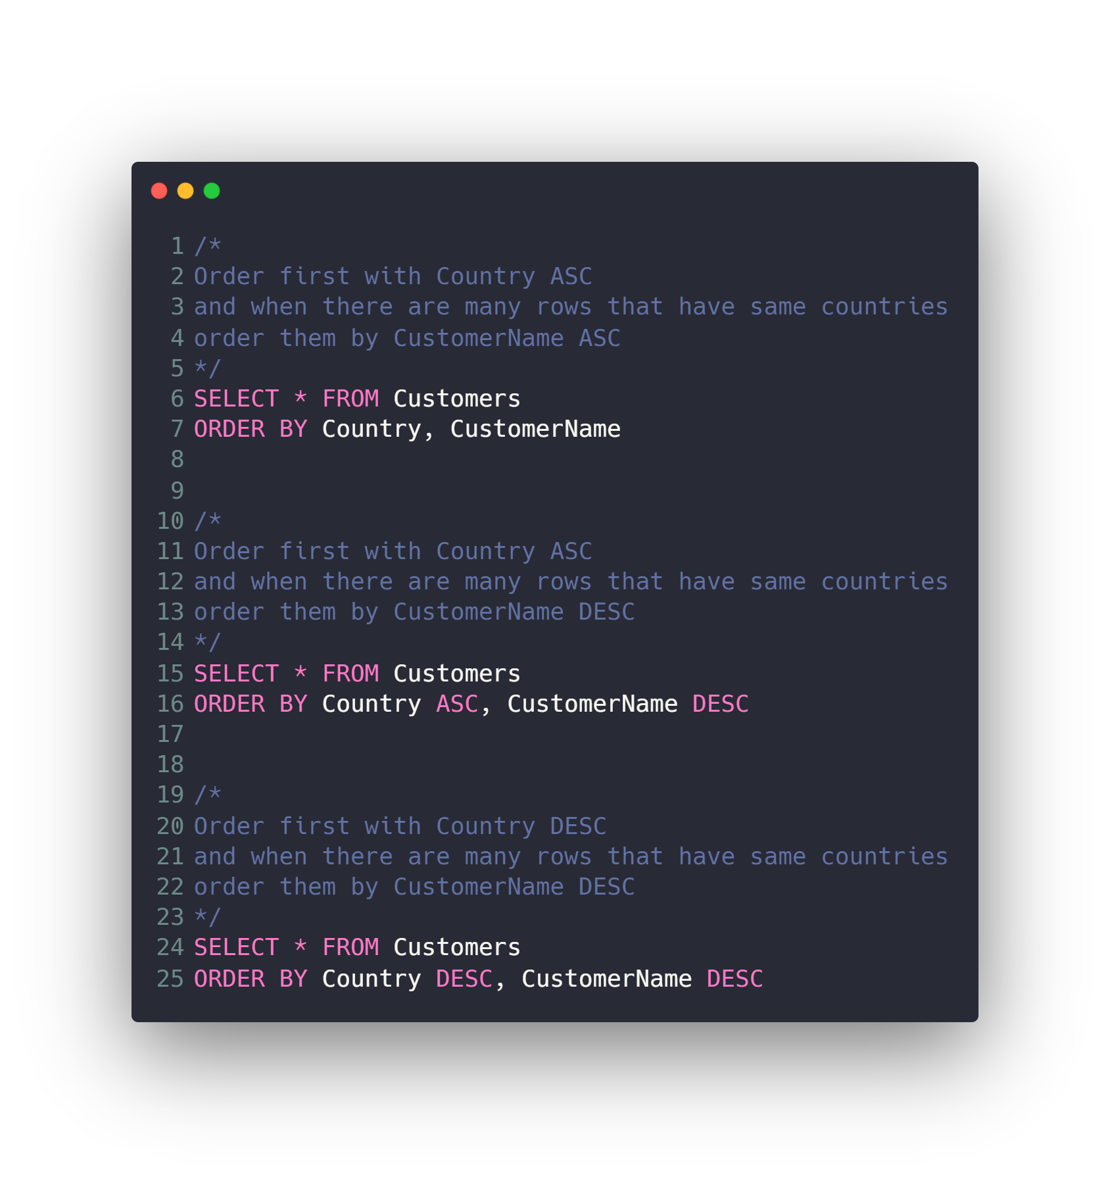
Ordering data
Order rows by single column ascending
Order rows by single column descending
Filter then Order
Order rows by several columns

Slide 38
Agenda
What is RDBMS.
Tables, Columns and Data types
How to design a database.
One-To-Many & Many-To-Many Relationships.
Examples: FB, Youtube, Souq.com
SQL
CRUD
Selecting data
Filtering data
Ordering data
Limiting data
Aggregate Functions
Joining tables
Grouping data
Subqueries
Inserting new data
Updating data
Deleting data
Python and SQLite
DB Browser for SQLite

Slide 39
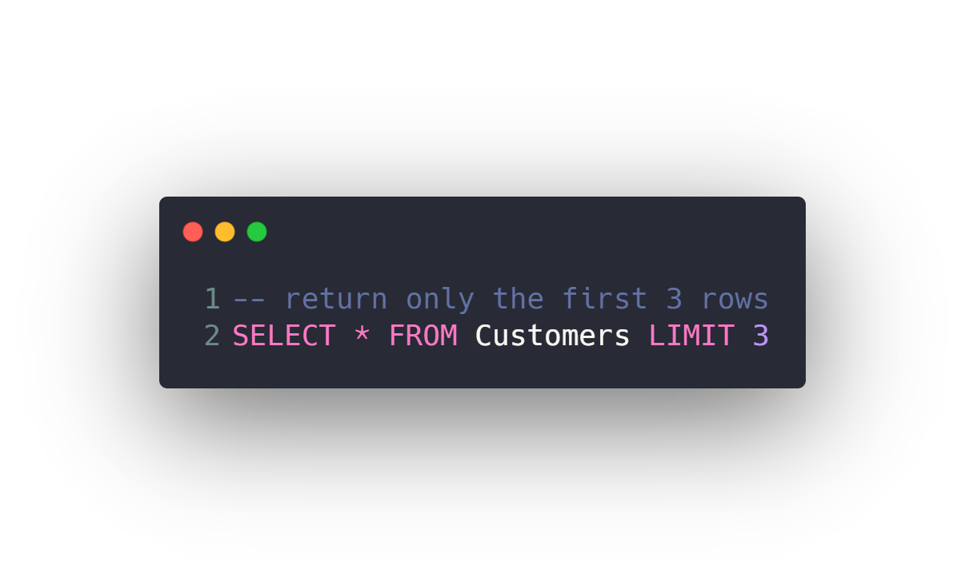
Limiting data
Limit resulted rows to a specific number from first row
Limit resulted rows to a specific number from a specific offset row

Slide 40
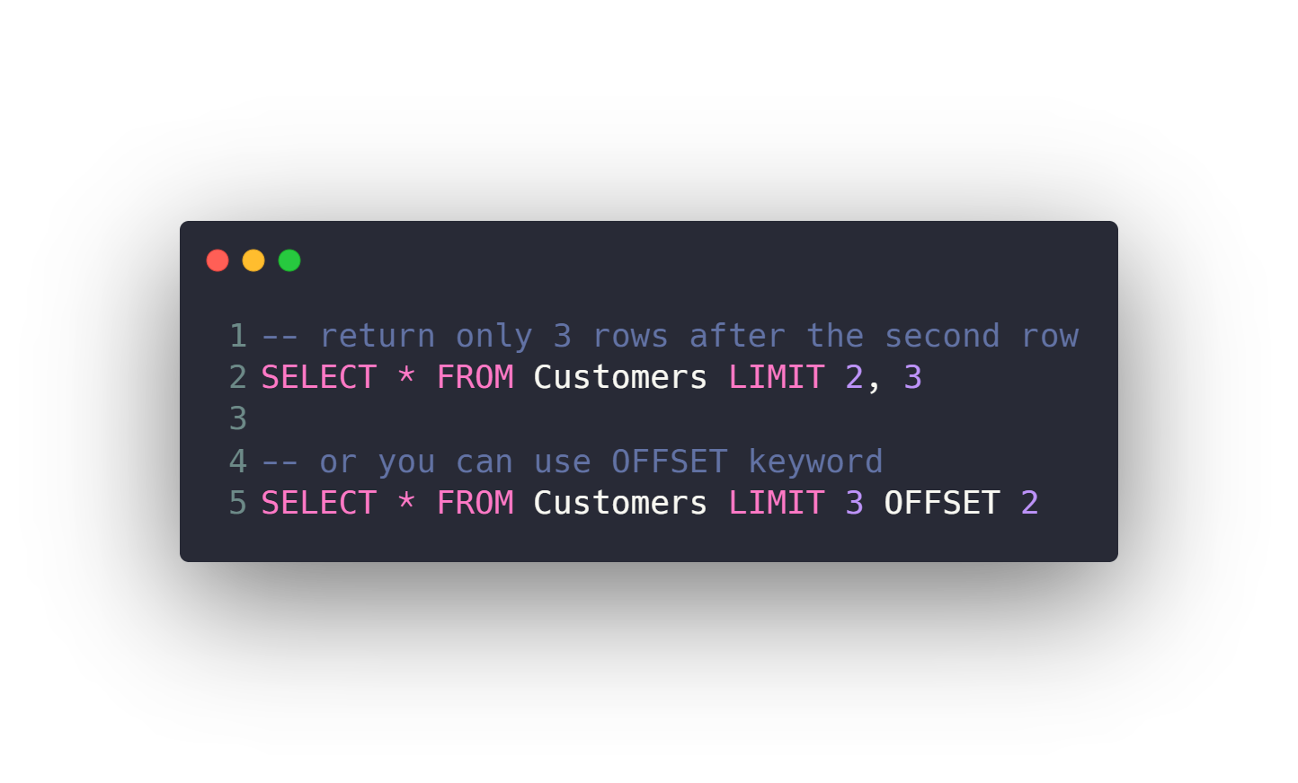
Limiting data
Limit resulted rows to a specific number from first row
Limit resulted rows to a specific number from a specific offset row

Slide 41
Agenda
What is RDBMS.
Tables, Columns and Data types
How to design a database.
One-To-Many & Many-To-Many Relationships.
Examples: FB, Youtube, Souq.com
SQL
CRUD
Selecting data
Filtering data
Ordering data
Limiting data
Aggregate Functions
Joining tables
Grouping data
Subqueries
Inserting new data
Updating data
Deleting data
Python and SQLite
DB Browser for SQLite

Slide 42
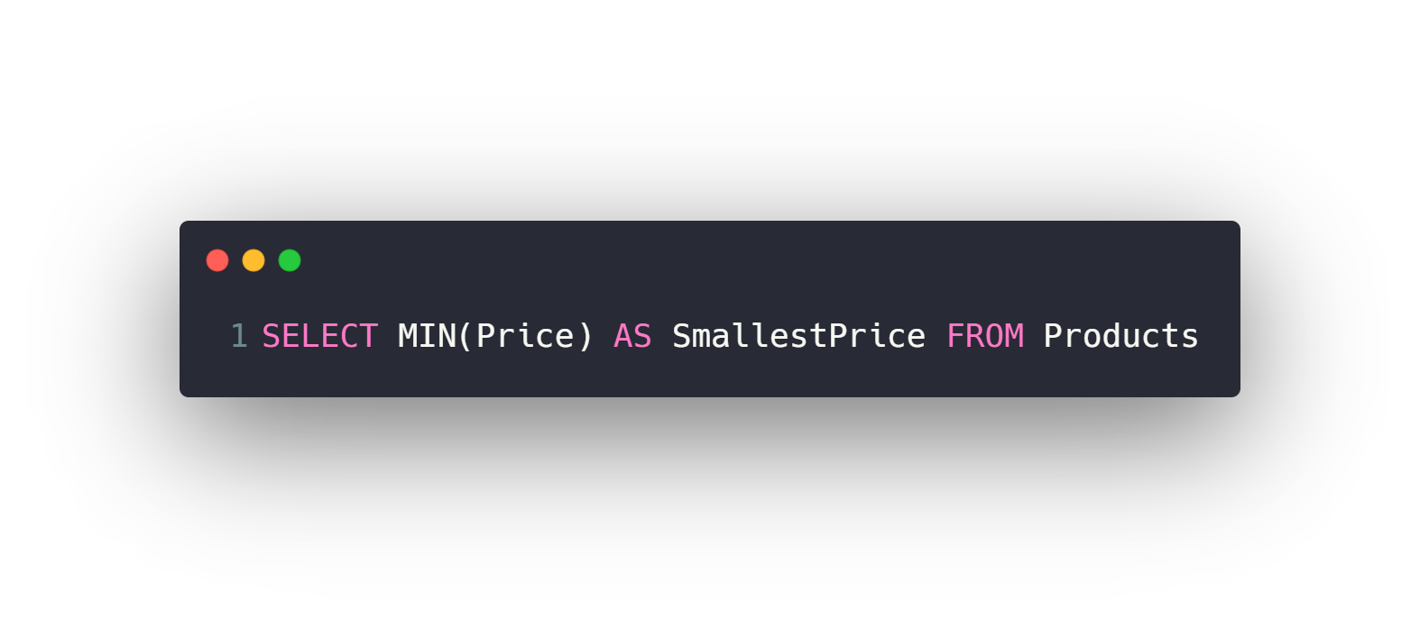
Aggregate Functions
MIN
MAX
COUNT
AVG
SUM

Slide 43
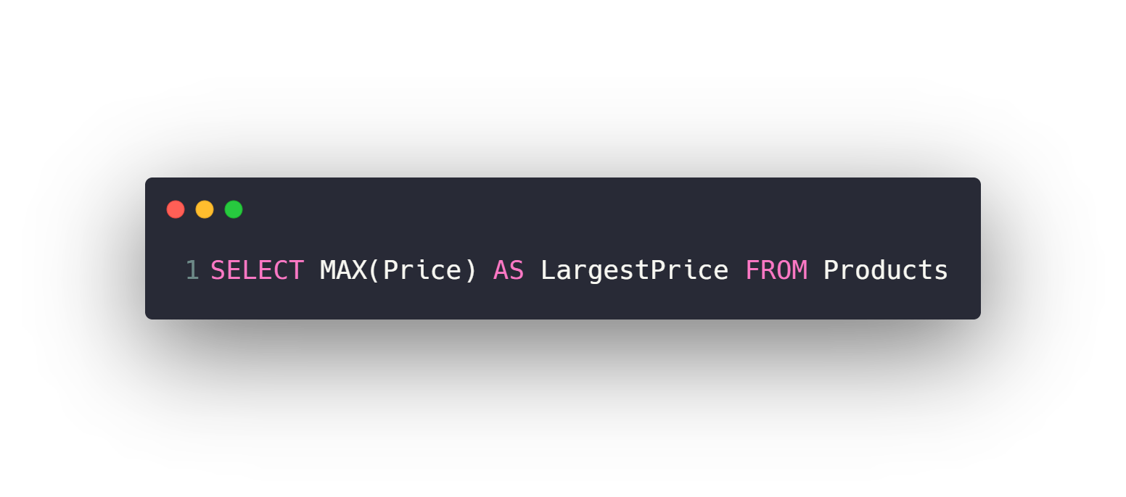
Aggregate Functions
MIN
MAX
COUNT
AVG
SUM

Slide 44
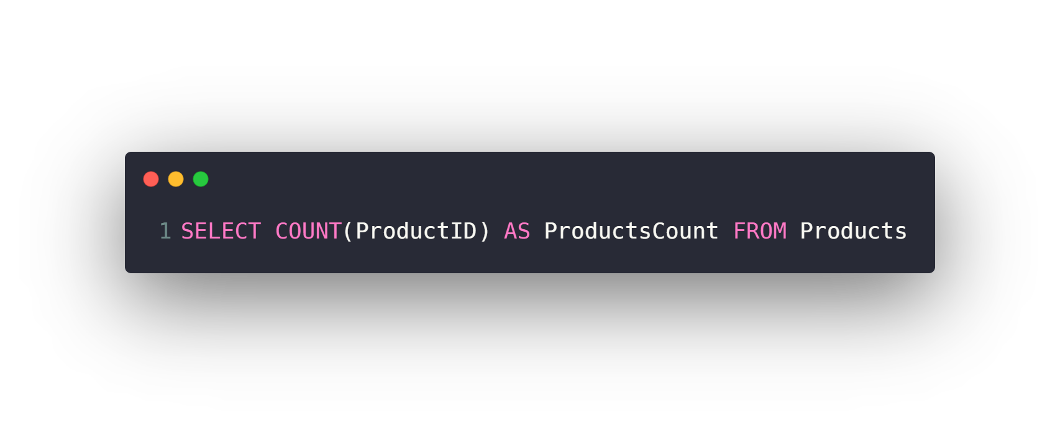
Aggregate Functions
MIN
MAX
COUNT
AVG
SUM

Slide 45
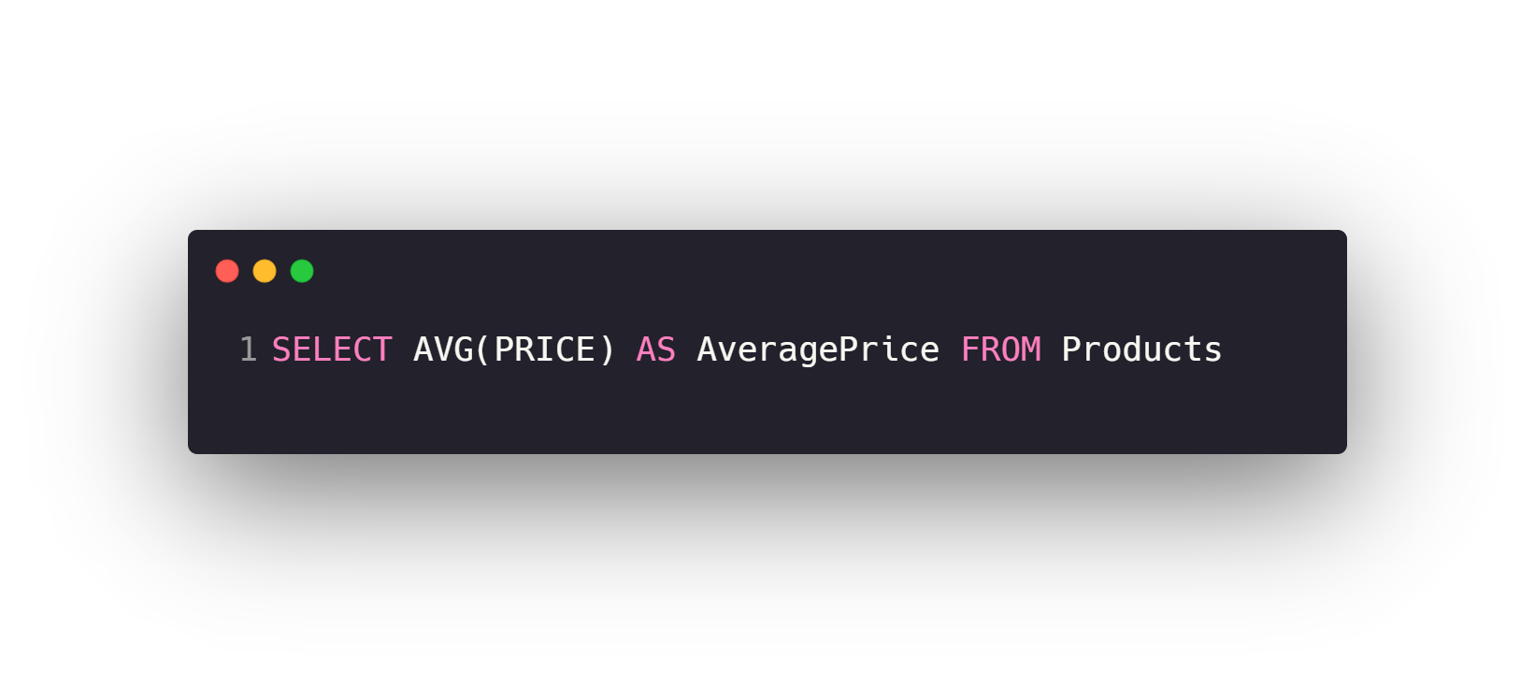
Aggregate Functions
MIN
MAX
COUNT
AVG
SUM

Slide 46
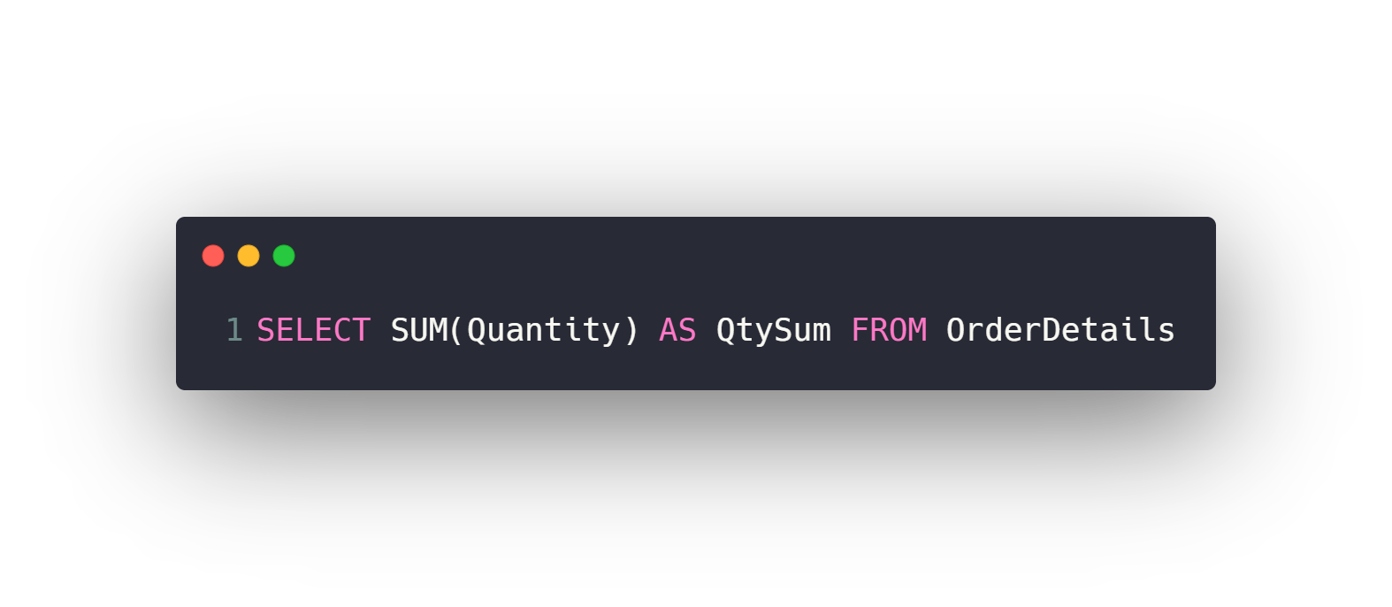
Aggregate Functions
MIN
MAX
COUNT
AVG
SUM

Slide 47
Agenda
What is RDBMS.
Tables, Columns and Data types
How to design a database.
One-To-Many & Many-To-Many Relationships.
Examples: FB, Youtube, Souq.com
SQL
CRUD
Selecting data
Filtering data
Ordering data
Limiting data
Aggregate Functions
Joining tables
Grouping data
Subqueries
Inserting new data
Updating data
Deleting data
Python and SQLite
DB Browser for SQLite

Slide 48
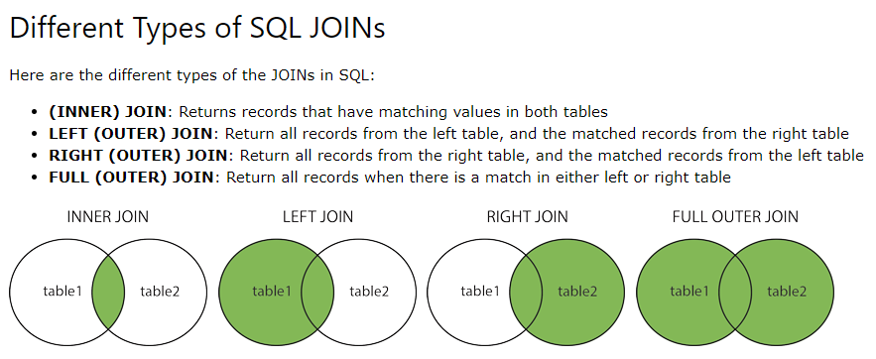
Joining tables

Slide 49
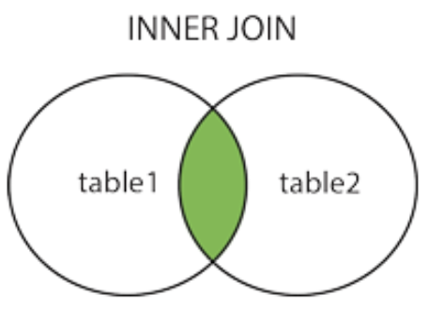
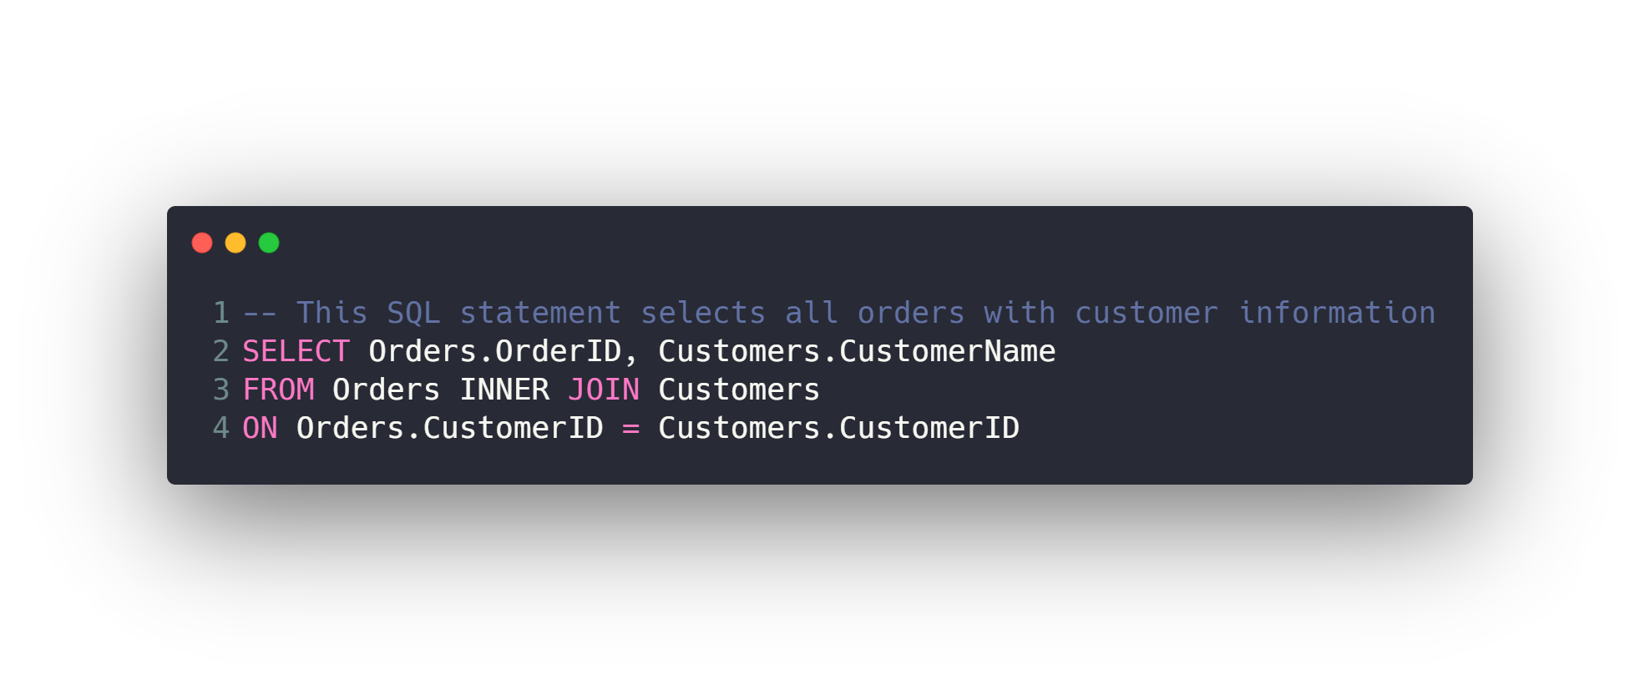
Joining tables (INNER)
The INNER JOIN keyword selects all rows from both tables as long
as there is a match between the columns. If there are records in
the "Orders" table that do not have matches in "Customers“,
these orders will not be shown!

Slide 50
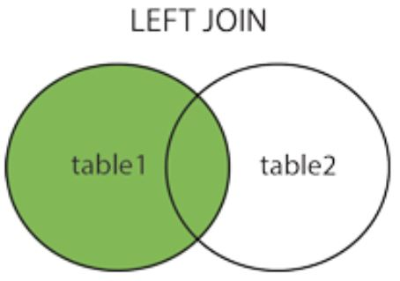
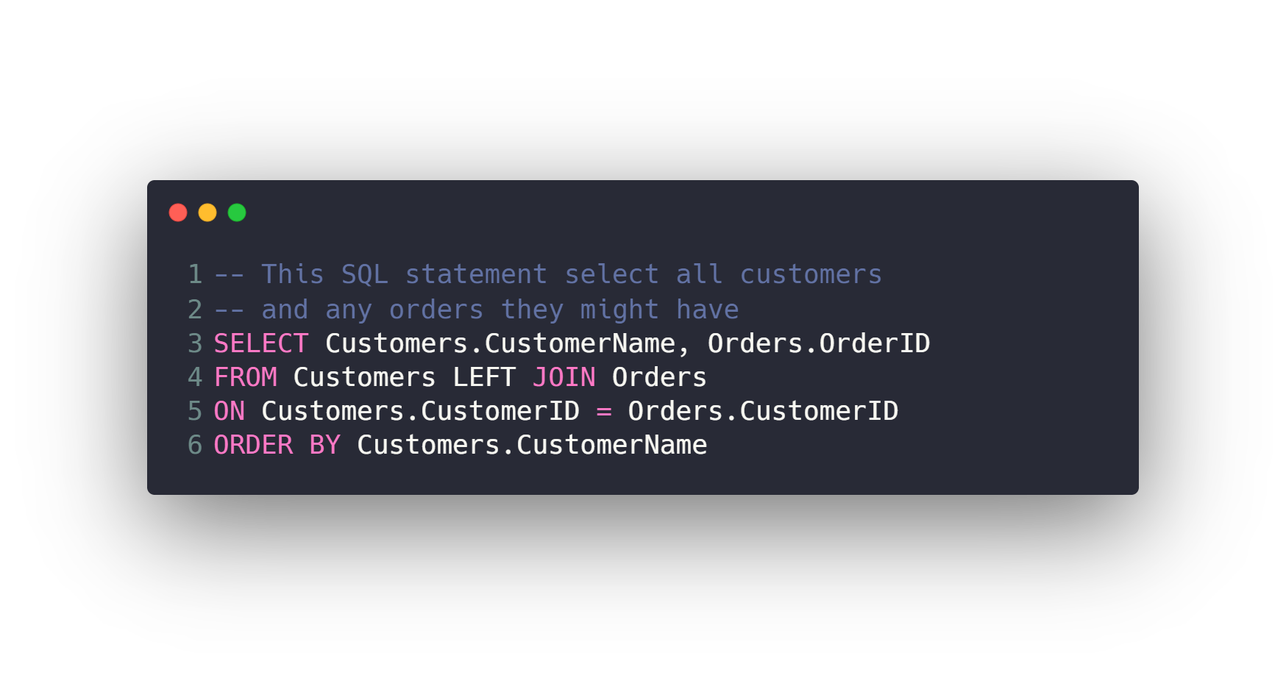
Joining tables (LEFT)
The LEFT JOIN keyword returns all records from the
left table (Customers), and the matched records from the
right table (Orders). The result is NULL from the right side,
if there is no match.

Slide 51
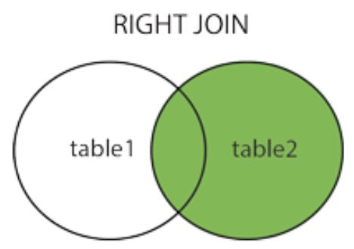
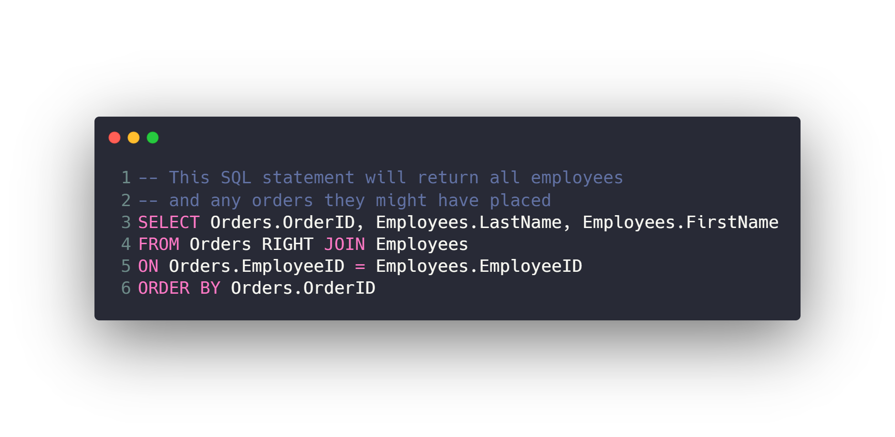
Joining tables (RIGHT)
The RIGHT JOIN keyword returns all records from the
right table (Employees), and the matched records from the
left table (Orders). The result is NULL from the
left side, when there is no match.

Slide 52
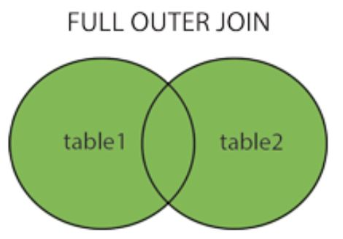
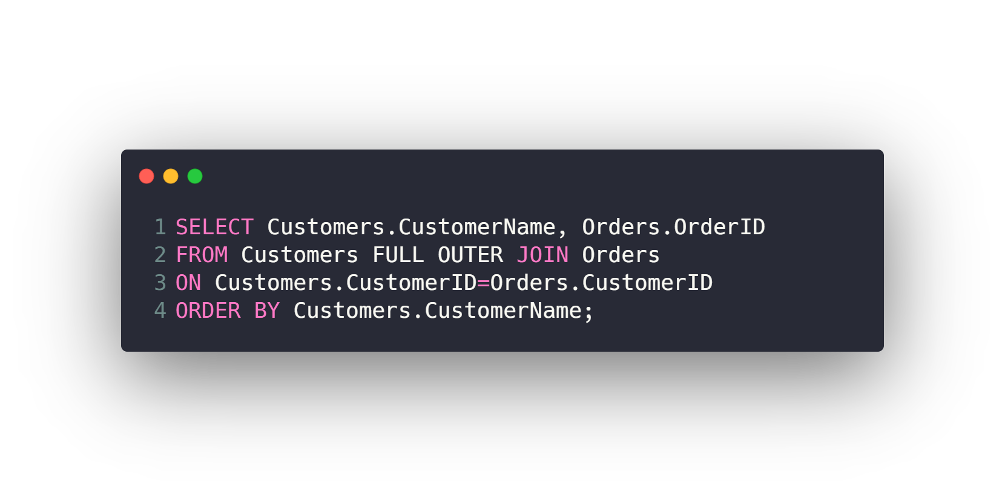
Joining tables (FULL)
The FULL OUTER JOIN keyword returns all matching records
from both tables whether the other table matches or not.
So, if there are rows in "Customers" that do not have matches
in "Orders", or if there are rows in "Orders" that do not have
matches in "Customers", those rows will be listed as
well with NULL

Slide 53
Agenda
What is RDBMS.
Tables, Columns and Data types
How to design a database.
One-To-Many & Many-To-Many Relationships.
Examples: FB, Youtube, Souq.com
SQL
CRUD
Selecting data
Filtering data
Ordering data
Limiting data
Aggregate Functions
Joining tables
Grouping data
Subqueries
Inserting new data
Updating data
Deleting data
Python and SQLite
DB Browser for SQLite

Slide 54
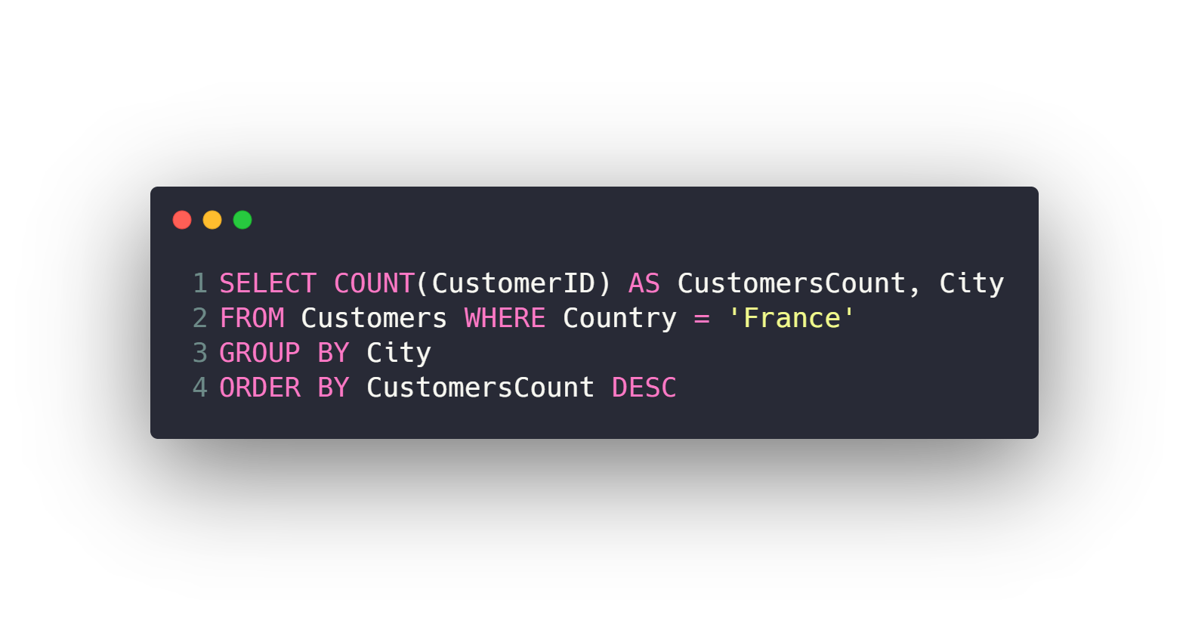
Grouping data
GROUP BY
HAVING

Slide 55
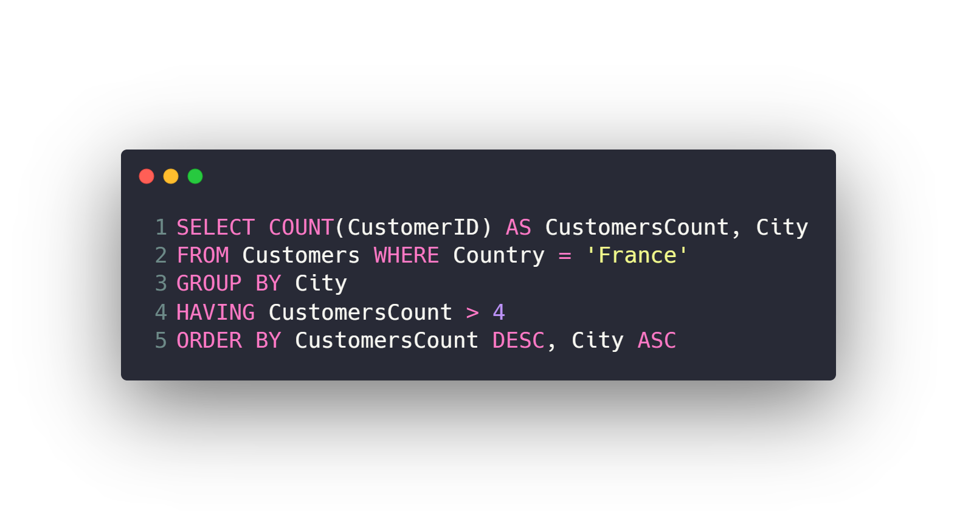
Grouping data
GROUP BY
HAVING

Slide 56
Agenda
What is RDBMS.
Tables, Columns and Data types
How to design a database.
One-To-Many & Many-To-Many Relationships.
Examples: FB, Youtube, Souq.com
SQL
CRUD
Selecting data
Filtering data
Ordering data
Limiting data
Aggregate Functions
Joining tables
Grouping data
Subqueries
Inserting new data
Updating data
Deleting data
Python and SQLite
DB Browser for SQLite

Slide 57
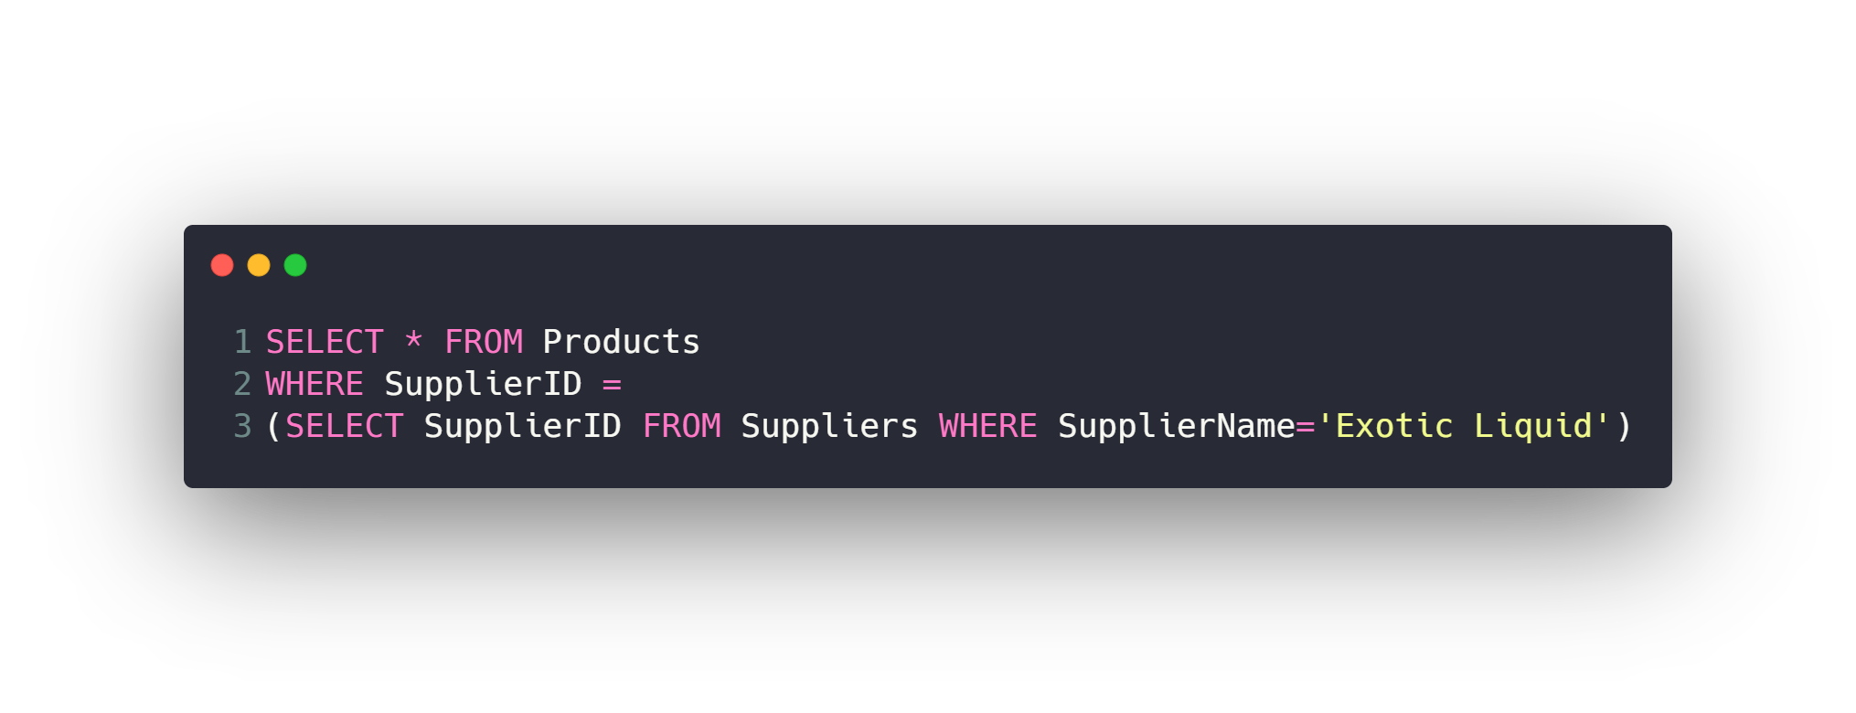
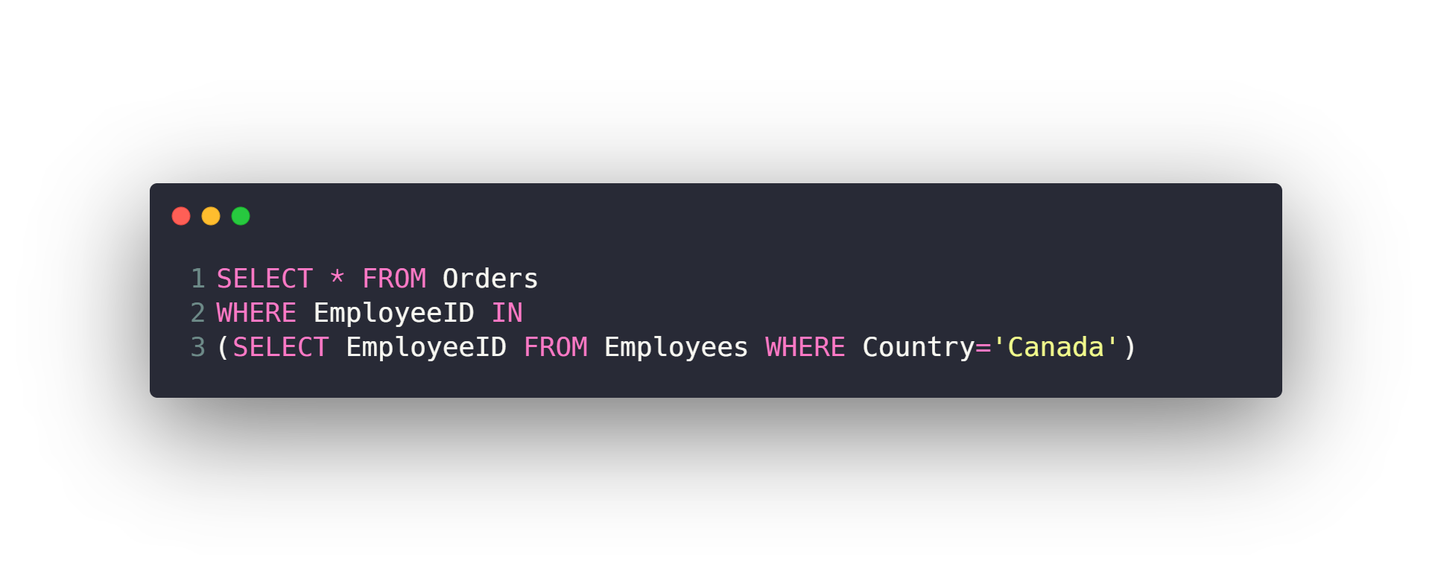
Subqueries

Slide 58
Agenda
What is RDBMS.
Tables, Columns and Data types
How to design a database.
One-To-Many & Many-To-Many Relationships.
Examples: FB, Youtube, Souq.com
SQL
CRUD
Selecting data
Filtering data
Ordering data
Limiting data
Aggregate Functions
Joining tables
Grouping data
Subqueries
Inserting new data
Updating data
Deleting data
Python and SQLite
DB Browser for SQLite

Slide 59
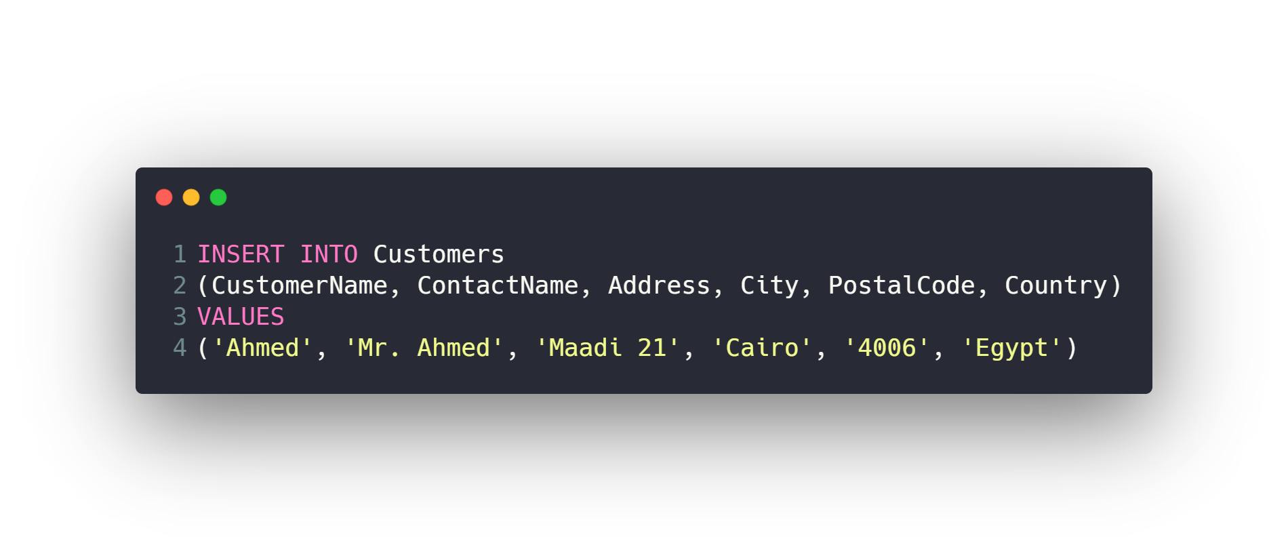
Inserting new data

Slide 60
Agenda
What is RDBMS.
Tables, Columns and Data types
How to design a database.
One-To-Many & Many-To-Many Relationships.
Examples: FB, Youtube, Souq.com
SQL
CRUD
Selecting data
Filtering data
Ordering data
Limiting data
Aggregate Functions
Joining tables
Grouping data
Subqueries
Inserting new data
Updating data
Deleting data
Python and SQLite
DB Browser for SQLite

Slide 61
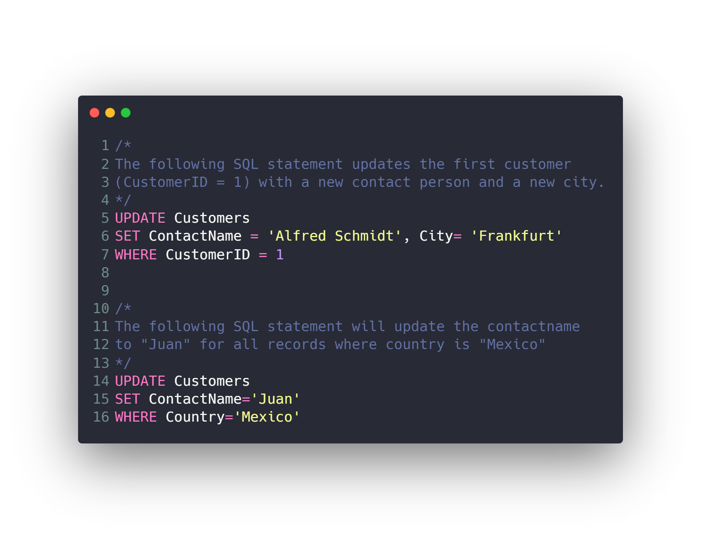
Updating data

Slide 62
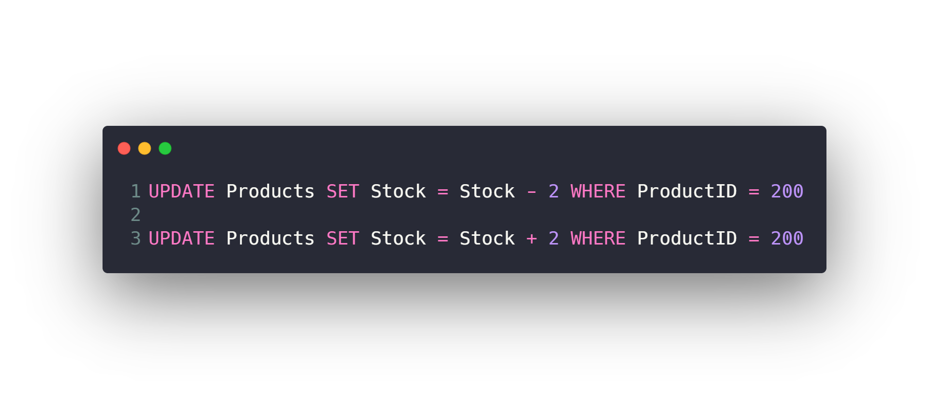
Updating data

Slide 63
Agenda
What is RDBMS.
Tables, Columns and Data types
How to design a database.
One-To-Many & Many-To-Many Relationships.
Examples: FB, Youtube, Souq.com
SQL
CRUD
Selecting data
Filtering data
Ordering data
Limiting data
Aggregate Functions
Joining tables
Grouping data
Subqueries
Inserting new data
Updating data
Deleting data
Python and SQLite
DB Browser for SQLite

Slide 64
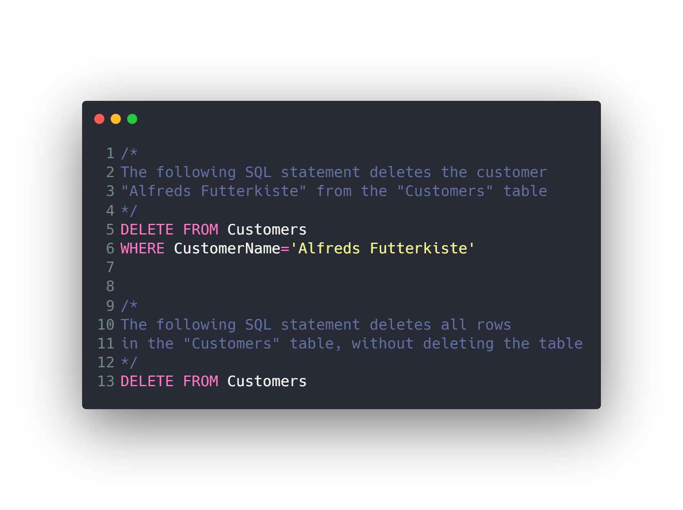
Deleting data

Slide 65
Check Also
Create / Drop / Backup Database
Create / Drop / Alter Table
Constraints (Not Null, Unique, Primary and Foreign Key)
Indexes
Database normalization
Transactions
Triggers & Stored Procedures
Views
SQL Injection
NoSQL
Replication
Shards

Slide 66
Agenda
What is RDBMS.
Tables, Columns and Data types
How to design a database.
One-To-Many & Many-To-Many Relationships.
Examples: FB, Youtube, Souq.com
SQL
CRUD
Selecting data
Filtering data
Ordering data
Limiting data
Aggregate Functions
Joining tables
Grouping data
Subqueries
Inserting new data
Updating data
Deleting data
Python and SQLite
DB Browser for SQLite

Slide 67
Python and SQLite
There is a lot of RDBMS out there
SQLite
MySQL
PostgreSQL
…
We will use SQLite because it’s simple and easy to work with.

Slide 68
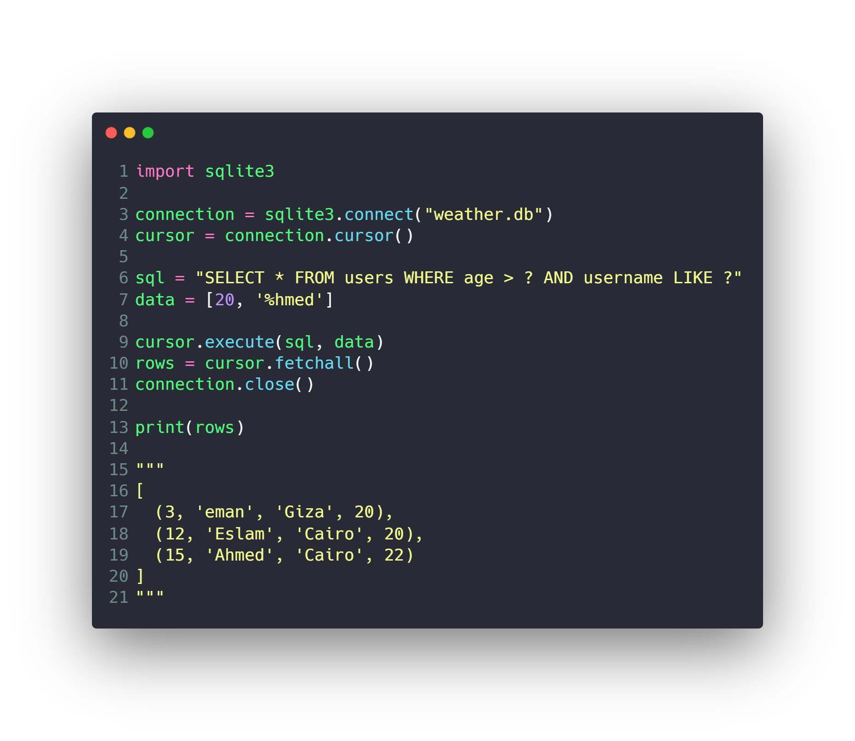
Python and SQLite
Read
Create
Update
Delete

Slide 69
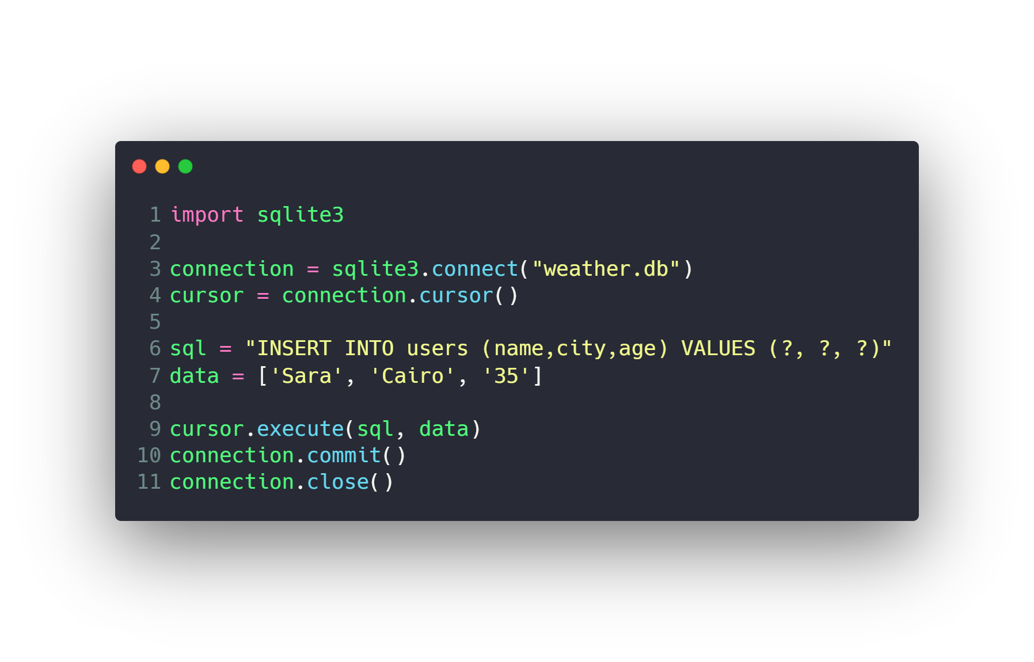
Python and SQLite
Read
Create
Update
Delete

Slide 70
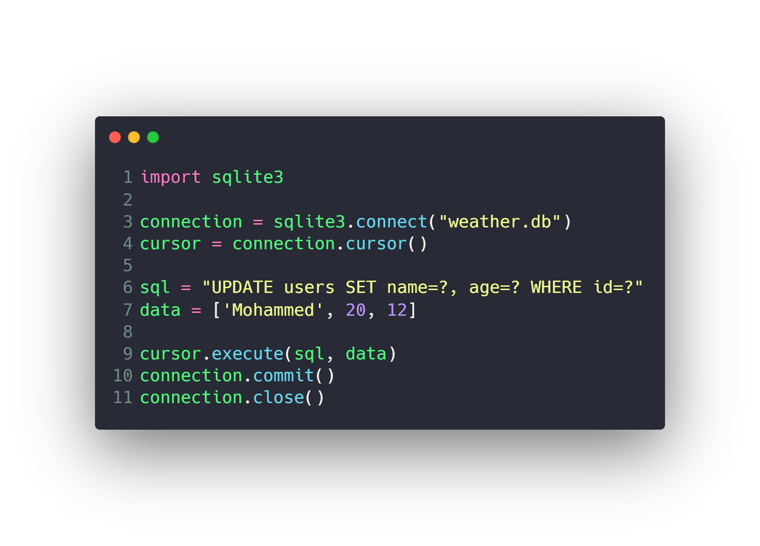
Python and SQLite
Read
Create
Update
Delete

Slide 71
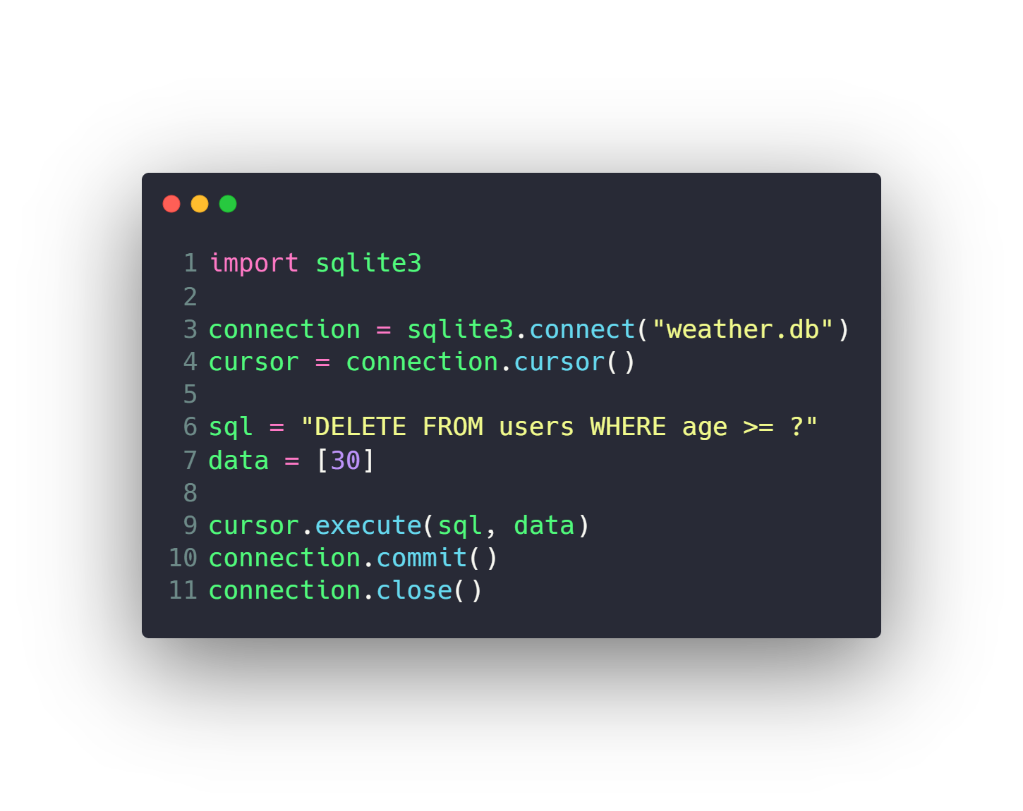
Python and SQLite
Read
Create
Update
Delete

Slide 72
Agenda
What is RDBMS.
Tables, Columns and Data types
How to design a database.
One-To-Many & Many-To-Many Relationships.
Examples: FB, Youtube, Souq.com
SQL
CRUD
Selecting data
Filtering data
Ordering data
Limiting data
Aggregate Functions
Joining tables
Grouping data
Subqueries
Inserting new data
Updating data
Deleting data
Python and SQLite
DB Browser for SQLite

Slide 73
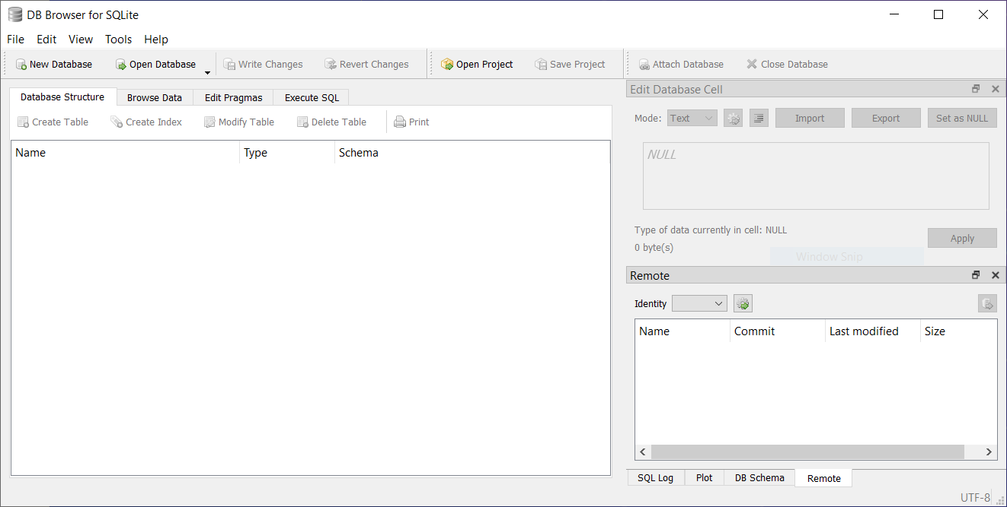
DB Browser for SQLite
GUI to work with SQLite
Download
https://sqlitebrowser.org
Tutorial
https://www.youtube.com/playlist?list=PLU70qqWW4frGdwNh4czgTrCrHvPhyt2aI

Slide 74
DB Browser for SQLite
Open Database
Create Database and tables
Create columns
Create Foreign Keys
Modify tables
CRUD with GUI
Execute SQL
Import from SQL file
Export table to CSV

Slide 75
Questions ?!

Slide 76

Thanks! >_ Live long and prosper

